Slide 1


UCLA MAE X SUSTENTO GROUP
PHASE 1
Notes:
Add names

Slide 2





MEET THE TEAM
Benedikt Graf
Nick Vincent
Nathan Kunz
Tony Sun
Madelyn Caufield
Faculty advisors: Prof. Randall R. Rojas and Prof. Patrick Convery.

Slide 3
AGENDA
INTRODUCTION
LA Better Buildings Challenge
Phase 1 Timeline
DATA PREPARATION
EBEWE Ordinance
CityBES
DACs
ANALYSIS APPROACH
EXTRAPOLATION RESULTS
FUTURE WORK
Notes:
Today we will be talking about
Maddie

Slide 4
LA BETTER BUILDINGS CHALLENGE
SHORT TERM
The LA Better Buildings Challenge is a program that aims to reduce energy consumption by 22% by 2025 in order to support “LA’s Best Buildings”.
LONG TERM
The City of Los Angeles and the US Department of Energy have set these targets as part of a larger goal of zero net emission by 2050.
LABBC GOALS
2020
Enroll 1,000 buildings
150M SF
2025
22% reductions
Enroll +20M SF / Year
2035
34% reductions
Create / Preserve 50,000 affordable housing units
Increase stability for renters
Notes:
https://www.la-bbc.com
Maddie

Slide 5
PHASE 1 TIMELINE
Project Kick-Off
CityBES Simulation
Free Retrofit Eligibility Extrapolation
Initial meeting with UCLA and Sustento Group
EEM Simulation Packages (LBNL Output)
Extrapolation of the important predictors of free retrofit eligibility from simulation data
November 2020
December 2020
January 2021
February 2021
March 2021
March 2021
EBEWE Initial Analysis
LBNL Output Characterization
Savings Extrapolation
Data characterization and regression
Conditional characterization and classification
Savings estimates for eligible buildings
Notes:
Maddie

Slide 6
DATA PREPARATION
Notes:
Speaker: Nate

Slide 7
EXISTING BUILDING ENERGY & WATER EFFICIENCY
EBEWE
WHO’S COVERED
Privately owned buildings that are ≥ 20,000 sqft
Located in the city of Los Angeles
Commercial, residential, industrial buildings, structured parking and condos
City-owned buildings ≥ 7,500 sqft
PERFORMANCE REQUIREMENTS
Annual benchmarking
Achieve efficiency targets:
ENERGY STAR Certification
15% reduction in energy use
20% reduction in water use
Annual benchmarking and reporting of buildings’ energy and consumption using ENERGY STAR Portfolio Manager
Notes:
https://www.betterbuildingsla.com/performance-pathways/how-to-comply

Slide 8
Size Rank | Property Type | Wave 1 (2021) | Wave 2 (2022) | Wave 3 (2023) | Wave 4 (2024) | Wave 5 (2025) | Total
1 | Multi-Family Residential | 662 | 650 | 652 | 648 | 680 | 3292
2 | Office | 176 | 158 | 169 | 167 | 169 | 839
3 | Non-Refrigerated Warehousing | 73 | 57 | 48 | 78 | 65 | 321
4 | Manufacturing/Industrial Plant | 64 | 63 | 66 | 66 | 61 | 320
5 | Distribution Center | 37 | 36 | 39 | 30 | 52 | 194
6 | Retail Stores | 30 | 26 | 33 | 38 | 29 | 156
7 | Self-Storage Facility | 33 | 34 | 39 | 25 | 21 | 152
8 | Mixed Use Property | 29 | 24 | 35 | 32 | 27 | 147
9 | Other | 30 | 26 | 34 | 20 | 26 | 136
10 | Parking | 18 | 26 | 27 | 25 | 19 | 115
11 | Other - Recreation | 22 | 22 | 21 | 28 | 21 | 114
12 | Hotel | 23 | 8 | 22 | 20 | 15 | 88
13 | Medical Office | 11 | 16 | 16 | 18 | 23 | 84
14 | Fire Station | 10 | 16 | 14 | 14 | 20 | 74
00 | All Other Property Types (58 total) | 164 | 179 | 181 | 178 | 167 | 869
00 | No Property Type Indicated (NA) | 999 | 945 | 921 | 1005 | 953 | 4823
00 | Total | 2381 | 2286 | 2317 | 2392 | 2348 | 11724

Slide 9

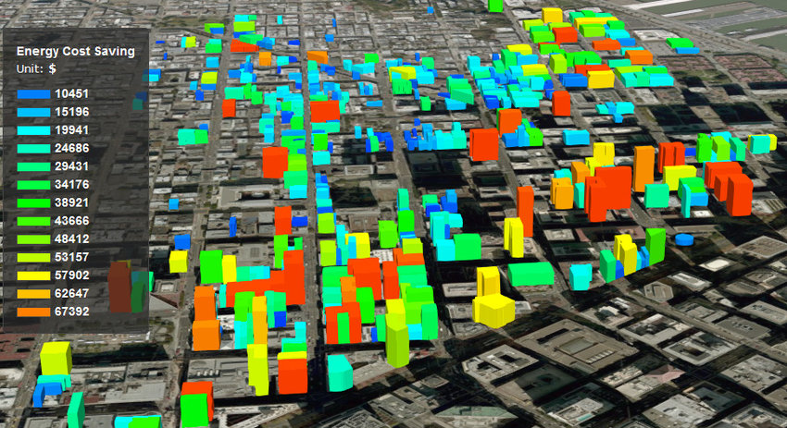
Place your screenshot here
CITY BUILDING ENERGY SAVER (CityBES)
Web-based data and computing platform, focusing on energy modeling and analysis of a city’s building stock to support district or city-scale efficiency programs
Notes:
Speaker: Nate
https://citybes.lbl.gov
I

Slide 10
CITYBES EEM PACKAGES
FREE (Basic)
EBEWE (Mid)
EBEWE + HVAC TRAD (Advanced 1)
EBEWE + HVAC ELEC (Advanced 2)
Notes:
Speaker: Nate
Going to include further breakdown
What’s the difference between the packages?

Slide 11
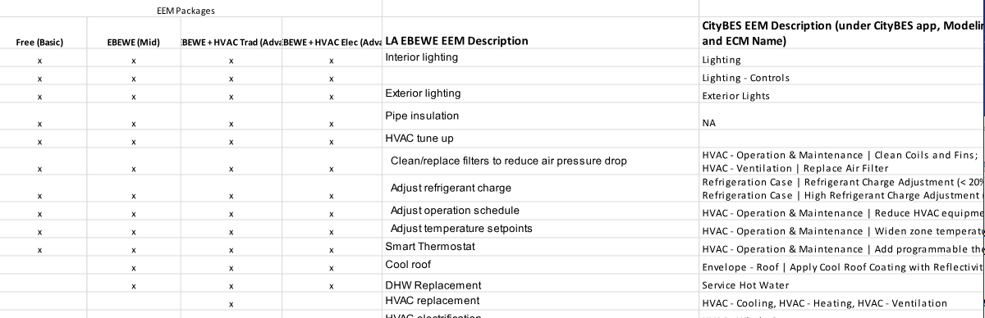
CITYBES EEM PACKAGES
Notes:
Speaker: Nate

Slide 12
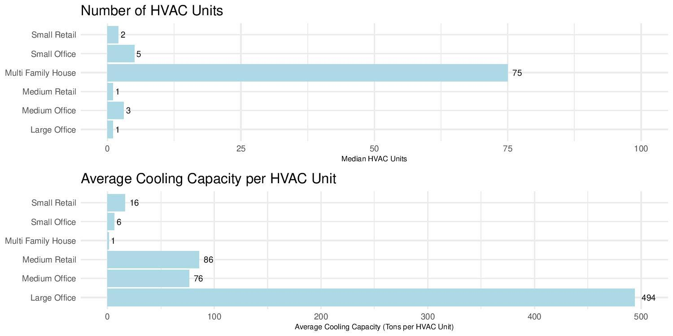
Notes:
Speaker: Nate

Slide 13
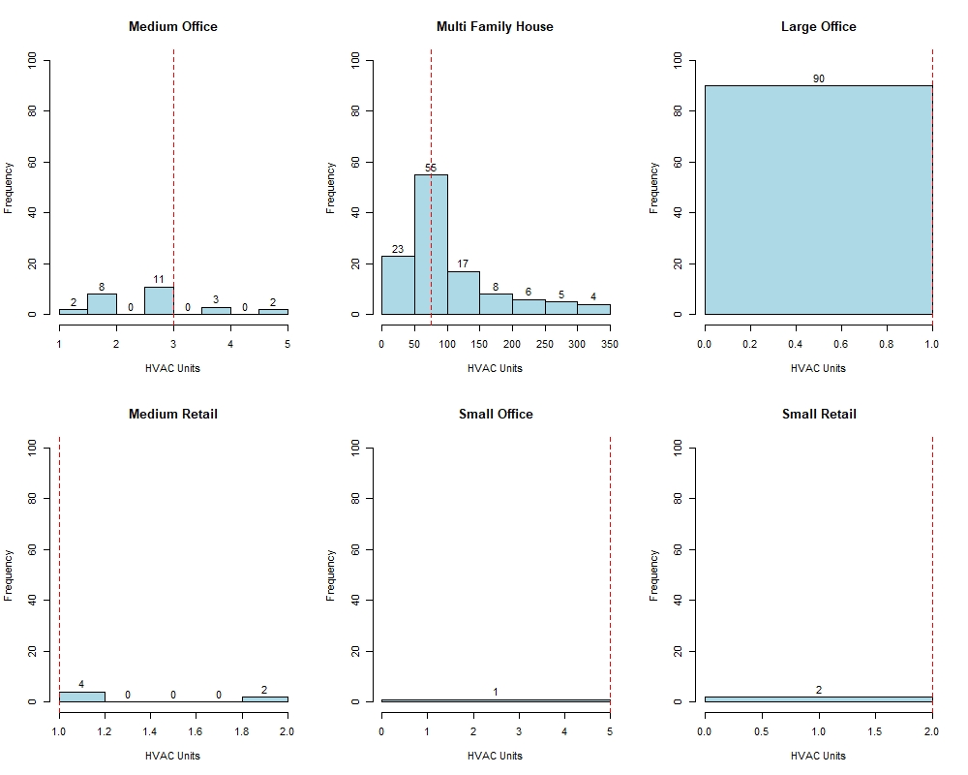
Notes:
Speaker: Nate

Slide 14
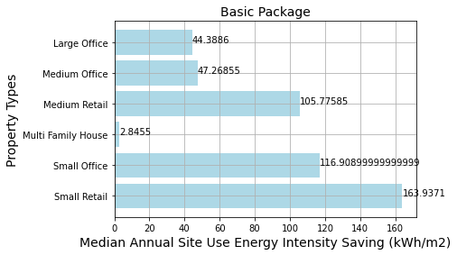
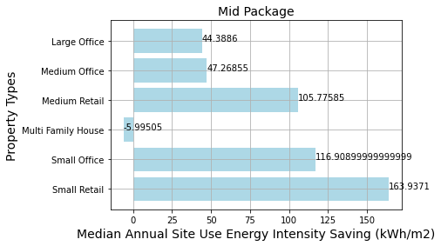
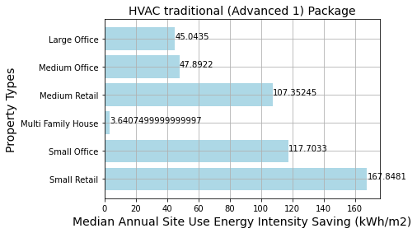
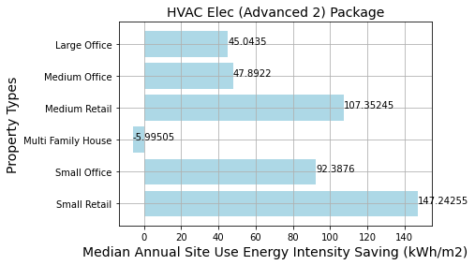
Notes:
Speaker: Nate
Maybe we want to produce some additional plots for floor area and annual water? Or maybe just leave in the plots for HVAC units and not include the independent vars.

Slide 15
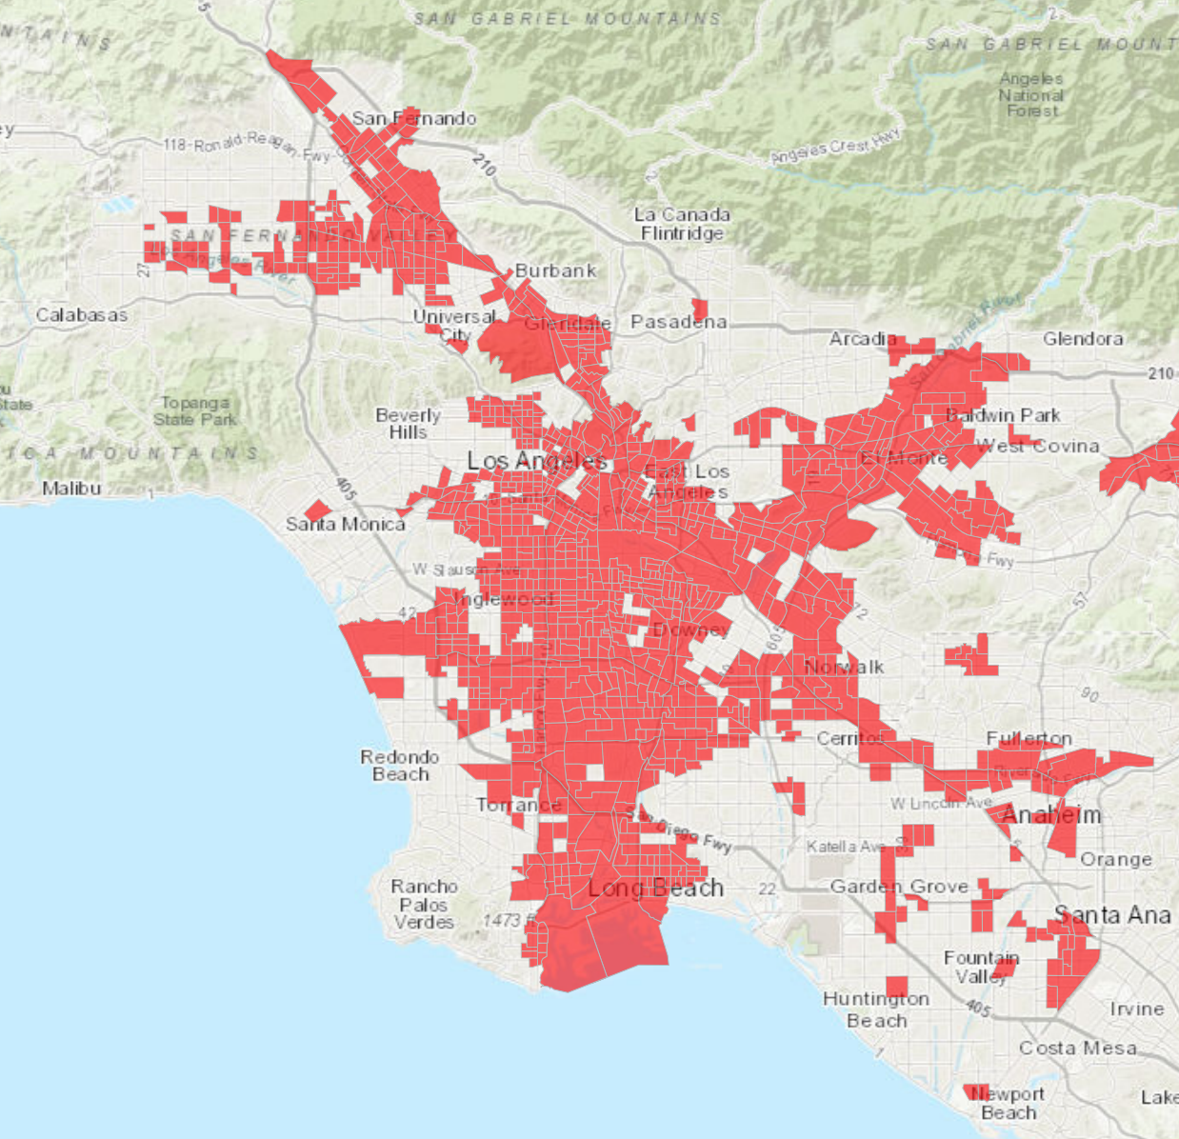
DISADVANTAGED COMMUNITIES (DACs)
To designate communities, CalEPA relied on the CalEnviroScreen results.
CalEnviroScreen is a mapping tool that helps identify California communities that are most affected by many sources of pollution, and where people are often especially vulnerable to pollution’s effects.
DACs represent the 25% highest scoring census tracts in the CalEnviroScreen tool.
Notes:
Speaker: Nick

Slide 16
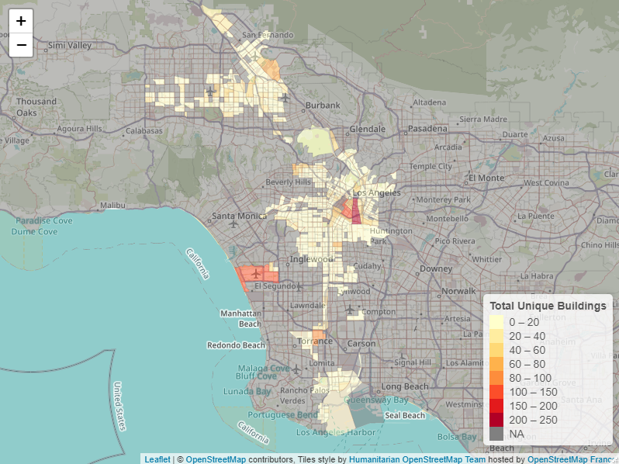
DISADVANTAGED COMMUNITIES (DACs)
Five (DAC) Census Tracts concentrate a large amount of unique buildings
These Census Tracts are as follows:
206031 with 233 unique buildings
226002 with 145 unique buildings
980028 with 140 unique buildings
207301 with 112 unique buildings
292000 with 86 unique buildings
The remainder in Disadvantaged Communities contain between 1 to 73 unique building observations each
5822 unique EBEWE Buildings are within a DAC
Notes:
Speaker: Nick

Slide 17
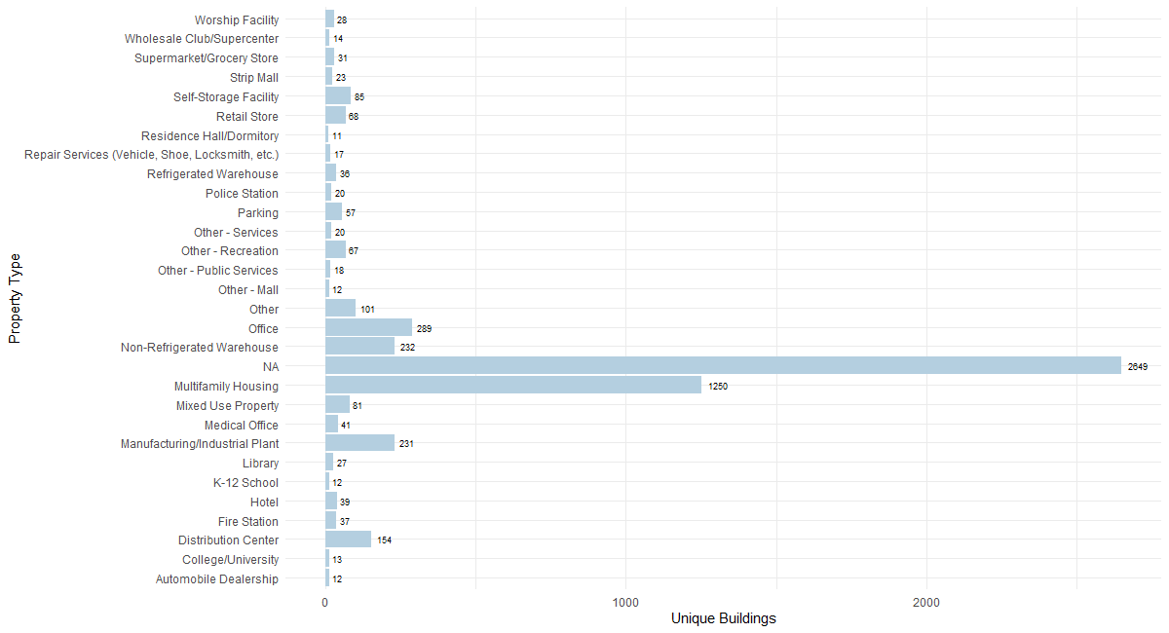
PROPERTY TYPES IN DISADVANTAGED COMMUNITIES (DACs)
Notes:
The highest amount of identifiable buildings that are in a DAC is Multifamily Housing at 1250 buildings. Office is third with 289 and Retail at 68.
Speaker: Nick

Slide 18
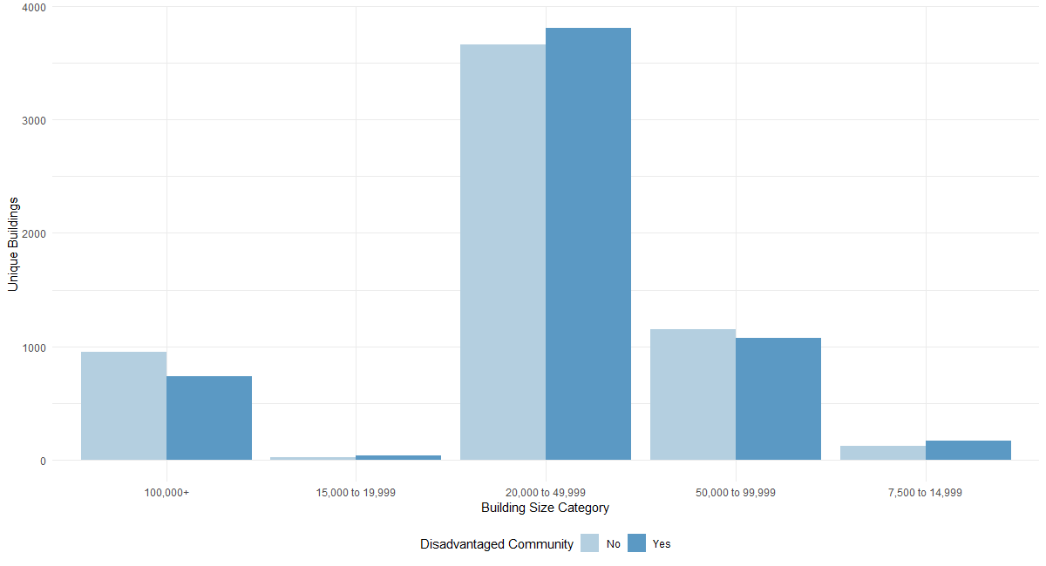
Notes:
The majority of buildings are 20,000-49,999 sqft AND the majority of buildings in a DAC are 20,000-49,999 sqft. This indicates that the majority of the buildings in the EBEWE dataset (and majority that we are using for our analysis) are in a DAC.
Speaker: Nick

Slide 19
BIG PICTURE
Which buildings from the EBEWE data set are eligible for a free retrofit?
How much will the free retrofit save?
Notes:
Let’s take a step back…
-tony

Slide 20


AC Optimization Program (AC OP)
Commercial Direct Install (CDI)
Commercial Direct Install (CDI) Program is an excellent way for your business to reduce energy costs and save money.
Free assessment, energy-efficient products, and the installation are provided
LADWP offers the AC Optimization program to residential and commercial customers to help save on their cooling costs.
The AC Optimization Program provides services by certified, professional heating, ventilation, and air conditioning (HVAC) technicians to analyze cooling systems and provide basic maintenance and efficiency services.

Slide 21
LET’S BREAKDOWN THE FREE RETROFIT ELIGIBILITY REQUIREMENTS
Monthly kW Usage
Cooling Capacity Per HVAC Unit
HVAC Units and Types
Consumer direct install buildings must use less than 250 kW on a monthly basis
Customer must have a central air conditioner / central heat pump system less than 10 tons in size per unit
Phase 2, Identifying the HVAC Units and Types for those eligible
Notes:
HVAC units, HVAC kw, natural gas
Assumptions made to make extrapolations
-tony

Slide 22
ANALYSIS APPROACH
Notes:
Speaker: Ben

Slide 23
EXTRAPOLATION METHOD
Input Data
Identify Variables
Data Processing
Build Model
Apply Model
CityBES Simulation output merged with HVAC data
Select variables that simulation data and EBEWE dataset share
Adding indicator variables (for years)
Standardization of continuous variables
Remove outliers
Test which models capture the relationship between the variables and the metrics to be extrapolated best
Apply the best model to the EBEWE dataset to extrapolate metrics
Variables used:
Year Built
Floor Area (sqft)
Water usage (gal/sqft)
Site EUI (kBtu/sqft)
Metrics extrapolated:
HVAC Cooling Capacity
Natural Gas Usage
Number of HVAC units
HVAC Type
Savings
Models tested:
Linear Regression
k Nearest Neighbors
Notes:
Speaker: Ben
Note: Site EUI is just a predictor

Slide 24
OLS REGRESSION RESULTS (COOLING CAPACITY)
Independent Variables:
Year Built
Floor Area
Floor Area Squared
Site EUI
Building Type
Data Preprocessing:
Log Transformation on Dependent Variable
Independent Variable Normalization
Outlier Removal
Notes:
Nick

Slide 25
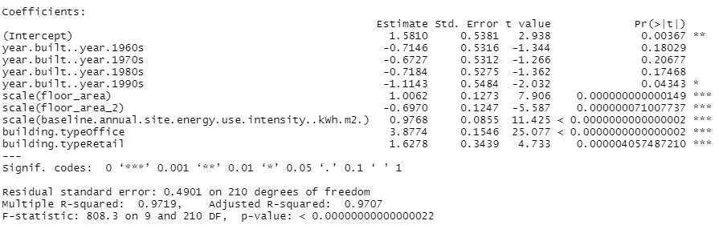
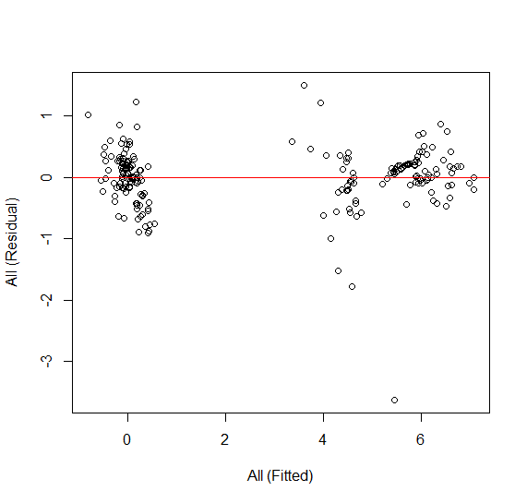
OLS REGRESSION RESULTS (COOLING CAPACITY)
Notes:
Nick

Slide 26
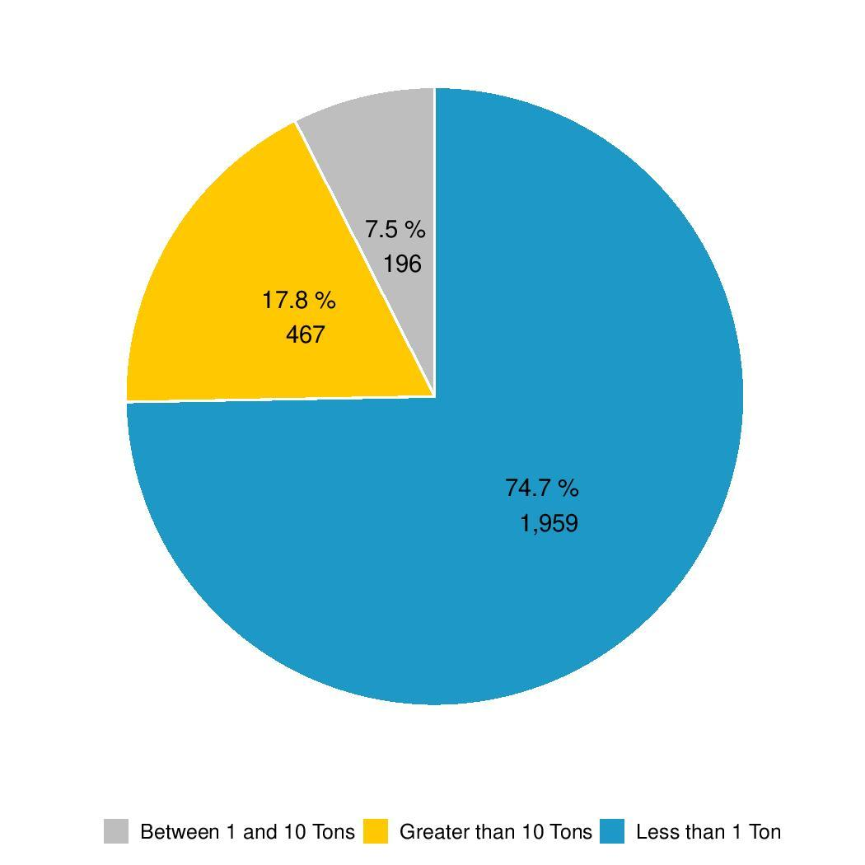
COOLING CAPACITY PREDICTION
Summary of Output
Retail:
Median 2.28 Tons per HVAC Unit
Multi-Family Housing:
Median 0.31 Tons per HVAC Unit
Office:
Median 23.12 Tons per HVAC Unit
Cooling Capacity per HVAC Unit Unit
Notes:
Nick

Slide 27
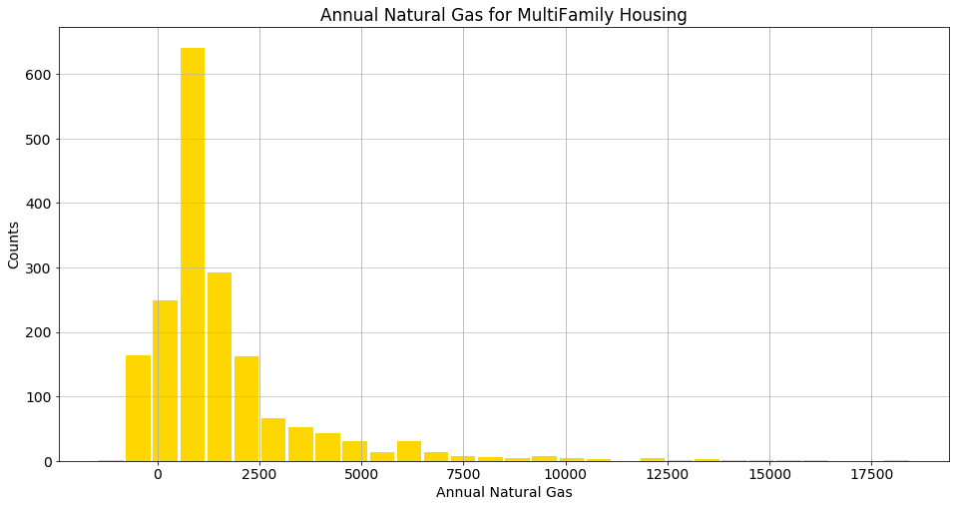
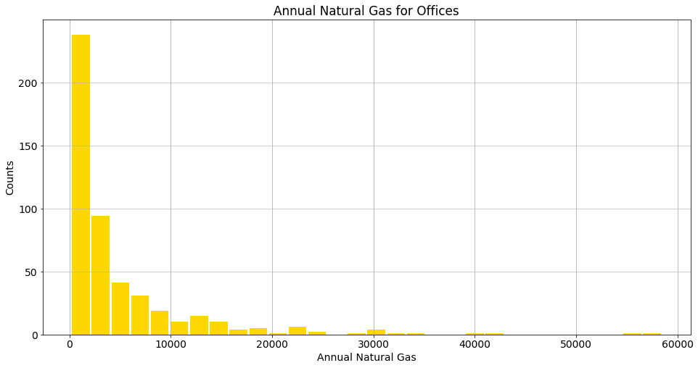
OLS REGRESSION RESULTS (NATURAL GAS USAGE)
Multi-family Housing
Offices
OLS Adjusted R-Squared: 0.94
OLS Accuracy: 0.871
Notes:
Nate

Slide 28
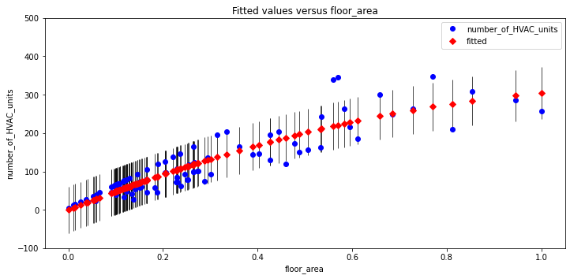
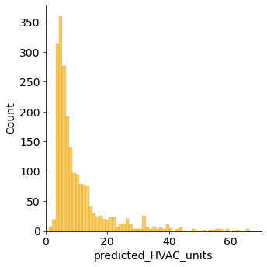
EXTRAPOLATION RESULTS (HVAC UNITS)
Multi-family Housing
OLS Accuracy: 0.94 kNN Accuracy: 0.45
Notes:
Speaker: Ben

Slide 29
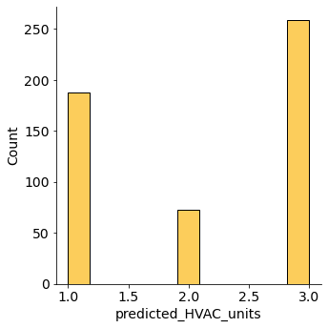
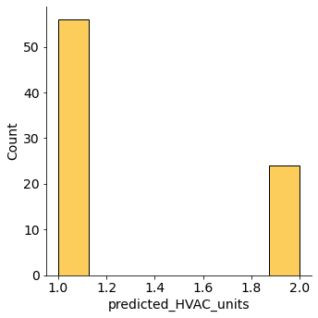
EXTRAPOLATION RESULTS (HVAC UNITS)
Multi-family Housing
Offices
Retail Stores
OLS Accuracy: 0.94 kNN Accuracy: 0.45
OLS Accuracy: 0.74 kNN Accuracy: 0.80
OLS Accuracy: 0.80 kNN Accuracy: 0.66
Notes:
Speaker: Ben

Slide 30
HVAC Types
Packaged Rooftop + Boiler
Packaged Rooftop AC + Gas Furnace
1
3
Central Chiller + Boiler
Split System AC + Gas Furnace
4
2
Notes:
ben

Slide 31
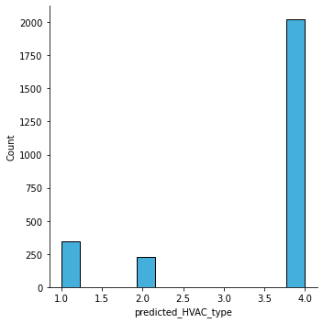
EXTRAPOLATION RESULTS (HVAC TYPE)
1: Packaged rooftop (VAV with reheat)-each story + boiler
2: Central chiller + boiler (VAV with reheat)
3: Packaged rooftop air conditioner+gas furnace - each zone
4: Split system air conditioner+gas furnace - each zone
kNN Accuracy: 0.98
Notes:
Speaker: Ben

Slide 32
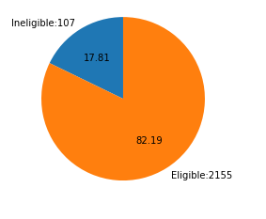
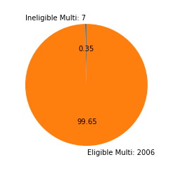
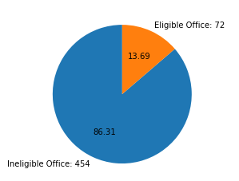
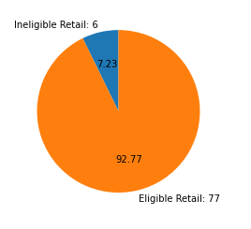
Categorical Percentage by Building Type for AC OP
Buildings, AC OP
Multi family, AC OP
Office, AC OP
Retail, AC OP
Notes:
Tony

Slide 33
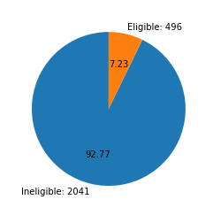
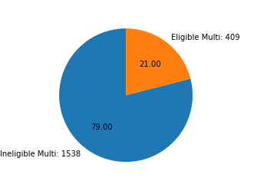
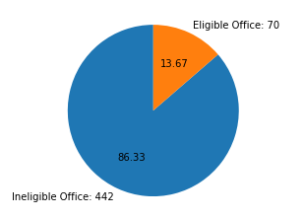
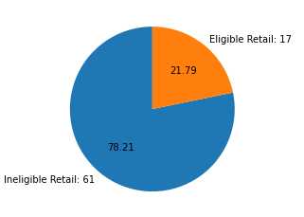
Categorical Savings Percentage by Building Type for CDI
Buildings, CDI
Multi family, CDI
Office, CDI
Retail, CDI
Notes:
Tony
Put behind slide 30

Slide 34
Building Types by Program Eligibility
AC Optimization
Retail: 77 buildings
Multi-Family Housing: 2006 buildings
Office: 72 buildings
Commercial Direct Install (CDI)
Retail: 17 buildings
Office: 70 buildings
2155 Buildings are eligible for AC Optimization
87 Buildings are eligible for CDI
Notes:
-tony

Slide 35
PREDICTED COST
& COST SAVING
Notes:
Speaker: Ben

Slide 36
GRAND TOTAL SAVINGS (Basic Package)
TOTAL INVESTMENT COST
AC Optimization
Grand Total: $45.5 Million
Commercial Direct Install
Grand Total: $662.3 Thousand
ANNUAL ELECTRICITY COST SAVING $
AC Optimization
Grand Total: $18.9 Million
Commercial Direct Install
Grand Total: $23.4 Million
ANNUAL ENERGY COST SAVING $
AC Optimization
Grand Total: $19.9 Million
Commercial Direct Install
Grand Total: $24.4 Million
ANNUAL NATURAL GAS COST SAVING $
AC Optimization
Grand Total: $1 Million
Commercial Direct Install
Grand Total: $999 Thousand
Notes:
This is only for the subset of buildings we've been analyzing imagine the savings with the other buildings

Slide 37
TOTAL INVESTMENT COST (Basic Package)
AC Optimization
Retail:
$1.2 Million (Total Inv. Cost)
$11.7 Thousand (Median Inv. Cost)
Multi-Family Housing:
$34.1 Million (Total Inv. Cost)
$12.7 Thousand (Median Inv. Cost)
Office:
$10.2 Million (Total Inv. Cost)
$16.4 Thousand (Median Inv. Cost)
Grand Total: $45.5 Million
Commercial Direct Install
Retail:
$81.2 Thousand (Total Inv. Cost)
$4.6 Thousand (Median Inv. Cost)
Multi-Family Housing:
$??? (Total Inv. Cost)
$??? (Median Inv. Cost)
Office:
$581.1 Thousand (Total Inv. Cost)
$9.3 Thousand (Median Inv. Cost)
Grand Total: $662.3 Thousand

Slide 38
ANNUAL ELECTRICITY COST SAVING $ PREDICTION (Basic Package)
AC Optimization
Retail:
$1.6 Million (Total Elec Cost Saving)
$13.7 Thousand (Median Elec Cost Saving)
Multi-Family Housing:
$764.3 Thousand (Total Elec Cost Saving)
$304 (Median Elec Cost Saving)
Office:
$16.6 Million (Total Elec Cost Saving)
$31.2 Thousand (Median Elec Cost Saving)
Grand Total: $18.9 Million
Commercial Direct Install
Retail:
$335.4 Thousand (Total Elec Cost Saving)
$14.3 Thousand (Median Elec Cost Saving)
Multi-Family Housing:
$79.7 Thousand (Total Elec Cost Saving)
$261 (Median Elec Cost Saving)
Office:
$23 Million (Total Elec Cost Saving)
$238.7 Thousand (Median Elec Cost Saving)
Grand Total: $23.4 Million
Notes:
the annual electricity cost saving for the three building types under each of the AC optimization and Commercial direct install eligibility constraints
We used the basic simulation dataset to extrapolate savings prediction to the buildings eligible for each of these programs listed above

Slide 39
ANNUAL ENERGY COST SAVING $ PREDICTION (Basic Package)
AC Optimization
Retail:
$1.6 Million (Total Annual Energy Cost Saving)
$13.8 Thousand (Median Annual Energy Cost Saving)
Multi-Family Housing:
$1.3 Million (Total Annual Energy Cost Saving)
$578 (Median Annual Energy Cost Saving)
Office:
$17 Million (Total Annual Energy Cost Saving)
$32 Thousand (Median Annual Energy Cost Saving)
Grand Total: $19.9 Million
Commercial Direct Install
Retail:
$332.7 Thousand (Total Annual Energy Cost Saving)
$14.3 Thousand (Median Annual Energy Cost Saving)
Multi-Family Housing:
$144.5 Thousand (Total Annual Energy Cost Saving)
$276 (Median Annual Energy Cost Saving)
Office:
$24 Million (Total Annual Energy Cost Saving)
$250.6 Thousand (Annual Energy Cost Saving)
Grand Total: $24.4 Million

Slide 40
ANNUAL NATURAL GAS COST SAVING $ PREDICTION (Basic Package)
AC Optimization
Retail:
-$10 Thousand (Total Annual Natural Gas Cost Saving)
$9 (Median Annual Natural Gas Cost Saving)
Multi-Family Housing:
$531.5 Thousand (Total Annual Energy Cost Saving)
$268 (Median Annual Energy Cost Saving)
Office:
$528.3 Thousand (Total Annual Natural Gas Cost Saving)
$1 Thousand (Median Annual Natural Gas Cost Saving)
Grand Total: $1 Million
Commercial Direct Install
Retail:
-$2.6 Thousand (Total Annual Natural Gas Cost Saving)
-$13 (Median Annual Natural Gas Cost Saving)
Multi-Family Housing:
$64.7 Thousand (Total Annual Energy Cost Saving)
$28 (Median Annual Energy Cost Saving)
Office:
$937 Thousand (Total Annual Natural Gas Cost Saving
$11.5 Thousand (Median Annual Natural Gas Cost Saving)
Grand Total: $999 Thousand

Slide 41

HVAC Units and Types for CDI Buildings
Notes:
Tony

Slide 42
FUTURE WORK PROPOSITIONS
PHASE 2
Larger sample of simulated data
Imputation methodology to estimate missing building data
Year built, EUI, Water Usage, Floor Area, Building Type, etc..
Hypothetical timeline for building waves and costs/savings
In-depth analysis on various simulation packages
Notes:
- tony

Slide 43
THANKS!
Questions?

Slide 44
APPENDIX

Slide 45
BUILDING TYPES and WAVES

Slide 46
Top Property Types by Total
Size Rank | Property Type | Wave 1 (2021) | Wave 2 (2022) | Wave 3 (2023) | Wave 4 (2024) | Wave 5 (2025) | Total
1 | Multi-Family Residential | 1467 | 1508 | 1490 | 1443 | 1486 | 7394
2 | Office | 486 | 413 | 455 | 445 | 461 | 2260
3 | Manufacturing/Industrial Plant | 165 | 140 | 158 | 156 | 142 | 761
4 | Non-Refrigerated Warehousing | 158 | 135 | 112 | 173 | 152 | 730
5 | Distribution Center | 92 | 85 | 89 | 70 | 125 | 461
6 | Other - Recreation | 86 | 87 | 81 | 112 | 80 | 446
7 | Parking | 69 | 79 | 90 | 75 | 73 | 386
8 | Self-Storage Facility | 82 | 70 | 98 | 63 | 51 | 364
9 | Other | 71 | 70 | 83 | 57 | 73 | 354
10 | Retail Stores | 66 | 55 | 76 | 76 | 71 | 344
11 | Mixed Use Property | 67 | 51 | 79 | 72 | 61 | 330
12 | Fire Station | 52 | 70 | 56 | 59 | 80 | 317
13 | Hotel | 58 | 25 | 58 | 66 | 45 | 252
14 | Medical Office | 33 | 39 | 49 | 61 | 51 | 233
00 | All Other Property Types (63 total) | 392 | 469 | 446 | 400 | 393 | 2100
00 | No Property Type Indicated (NA) | 4884 | 4640 | 4660 | 4899 | 4783 | 23866

Slide 47
All Property Types (77 Total)
Adult Education | Convention Center | Food Service | Mailing Center/Post Office | Other - Education | Other - Utility | Residential Care Facility | Supermarket/Grocery Store
Ambulatory Surgical Center | Courthouse | Hospital (General Medical & Surgical) | Manufacturing/Industrial Plant | Other - Entertainment/Public Assembly | Outpatient Rehabilitation/Physical Therapy | Restaurant | Transportation Terminal/Station
Automobile Dealership | Data Center | Hotel | Medical Office | Other - Lodging/Residential | Parking | Retail Store | Urgent Care/Clinic/Other Outpatient
Bank Branch | Distribution Center | Ice/Curling Rink | Mixed Use Property | Other - Mall | Performing Arts | Roller Rink | Veterinary Office
Bar/Nightclub | Enclosed Mall | Immeuble logements multiples | Movie Theater | Other - Public Services | Personal Services (Health/Beauty, Dry Cleaning) | Self-Storage Facility | Vocational School
Bowling Alley | Energy/Power Station | Indoor Arena | Multifamily Residential | Other - Recreation | Police Station | Senior Care Community | Wholesale Club/Supercenter
Bureau | Financial Office | K-12 School | Museum | Other - Restaurant/Bar | Pre-school/Daycare | Social/Meeting Hall | Worship Facility
College/University | Fire Station | Laboratory | Non-Refrigerated Warehouse | Other - Services | Refrigerated Warehouse | Stadium (Open)
Convenience Store with Gas Station | Fitness Center/Health Club/Gym | Library | Office | Other - Specialty Hospital | Repair Services (Vehicle, Shoe, Locksmith, etc.) | Stationnement
Convenience Store without Gas Station | Food Sales | Lifestyle Center | Other | Other - Technology/Science | Residence Hall/Dormitory | Strip Mall

Slide 48
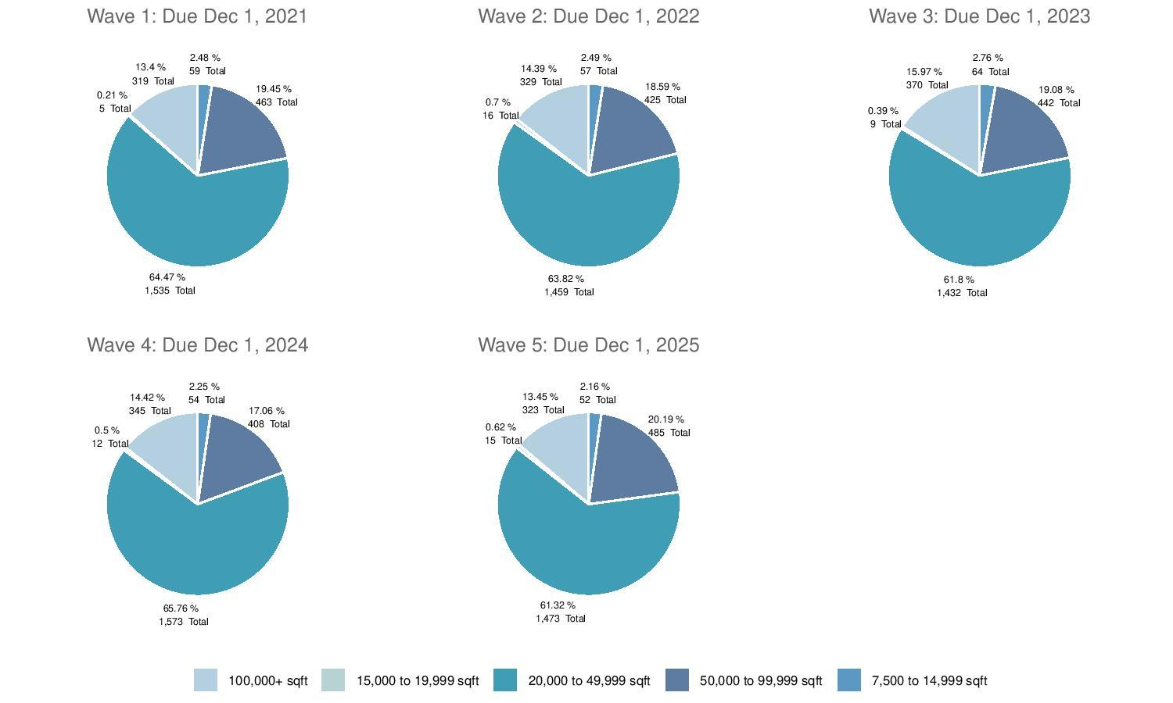
All Property Types by Wave and SQFT

Slide 49
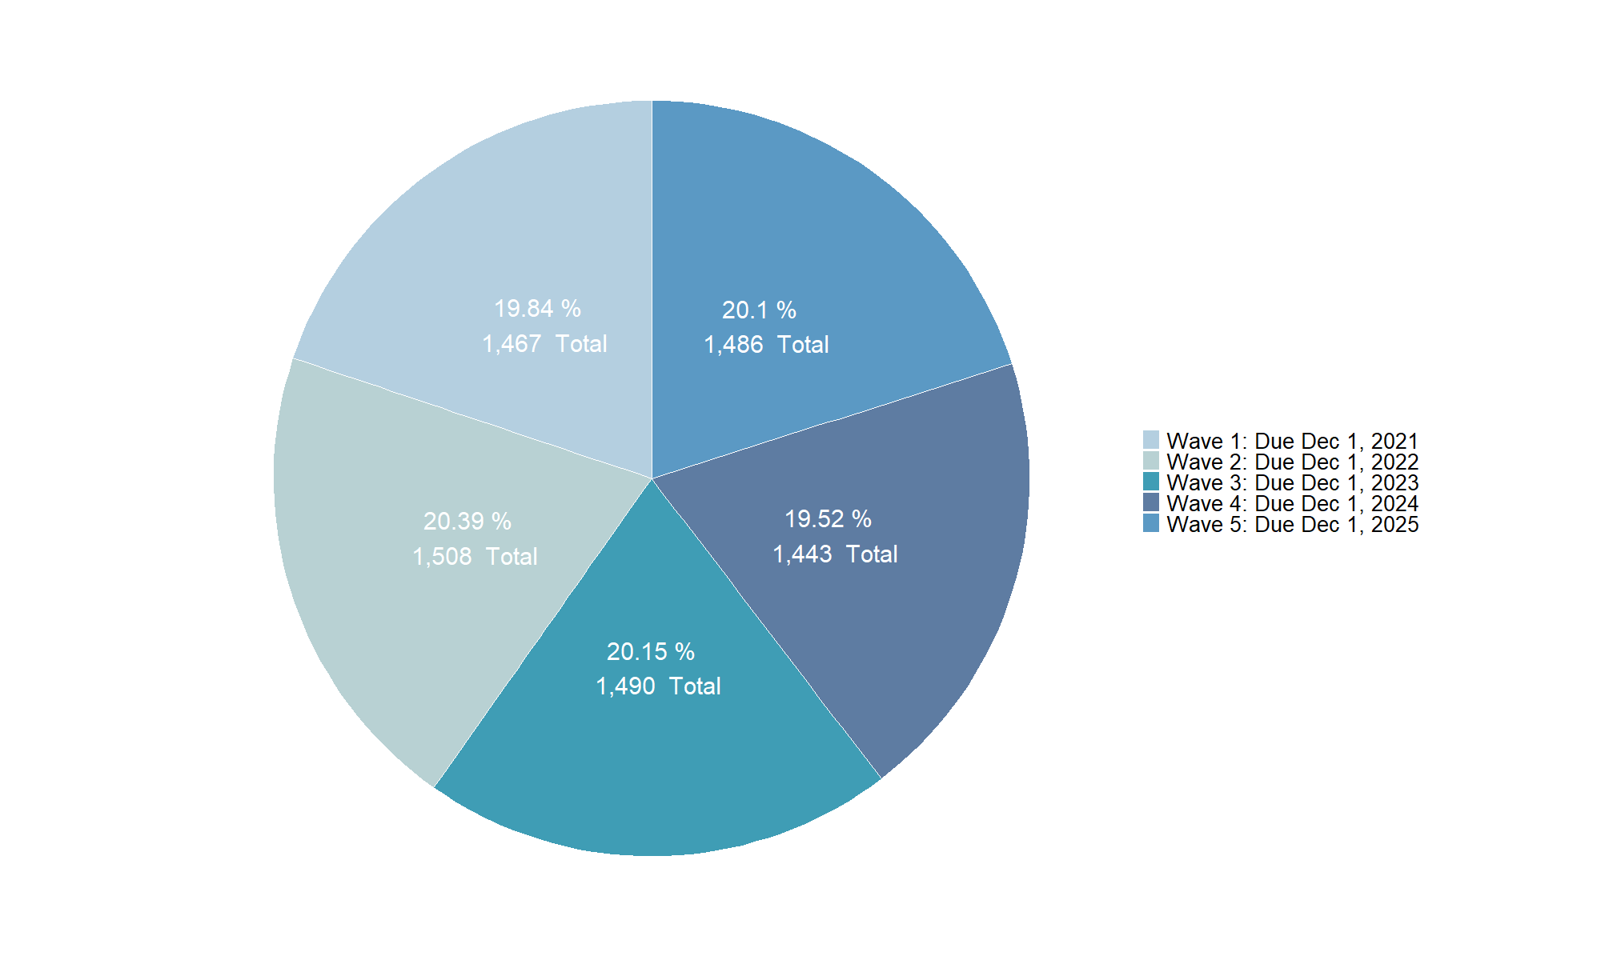
Multi-Family Residential by Wave

Slide 50
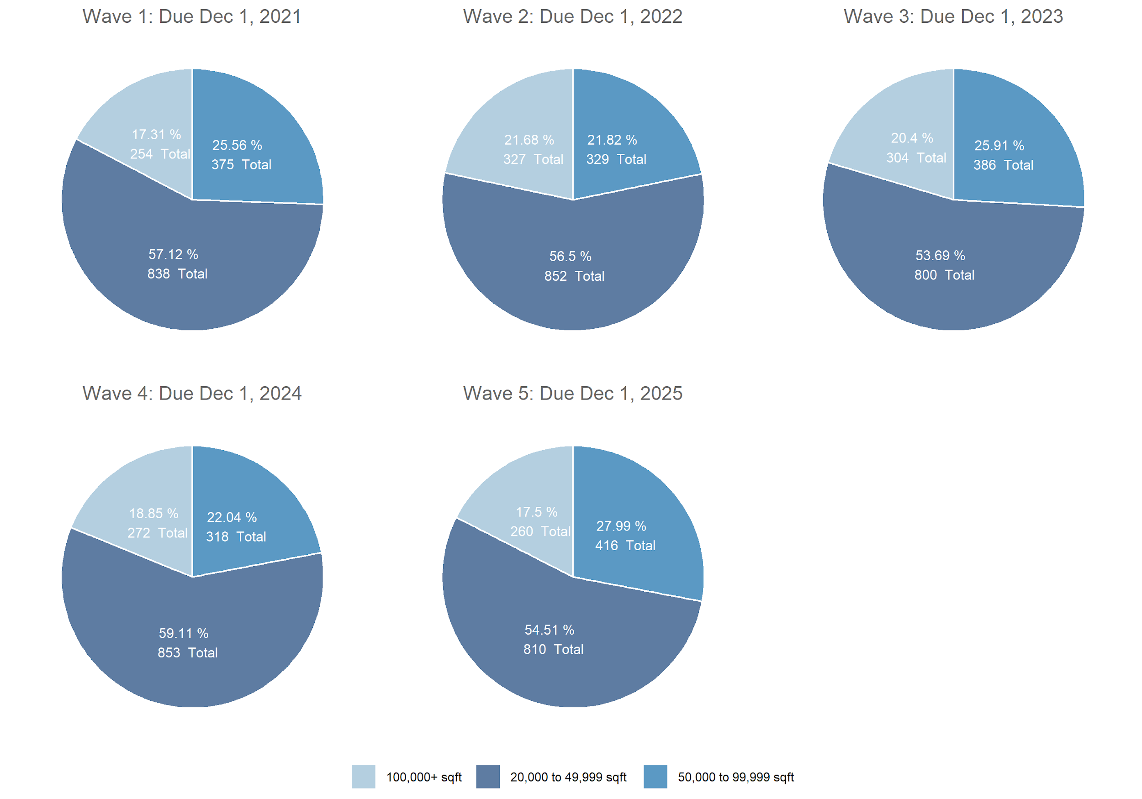
Multi-Family Residential by Wave and SQFT

Slide 51

Office Buildings by Wave

Slide 52
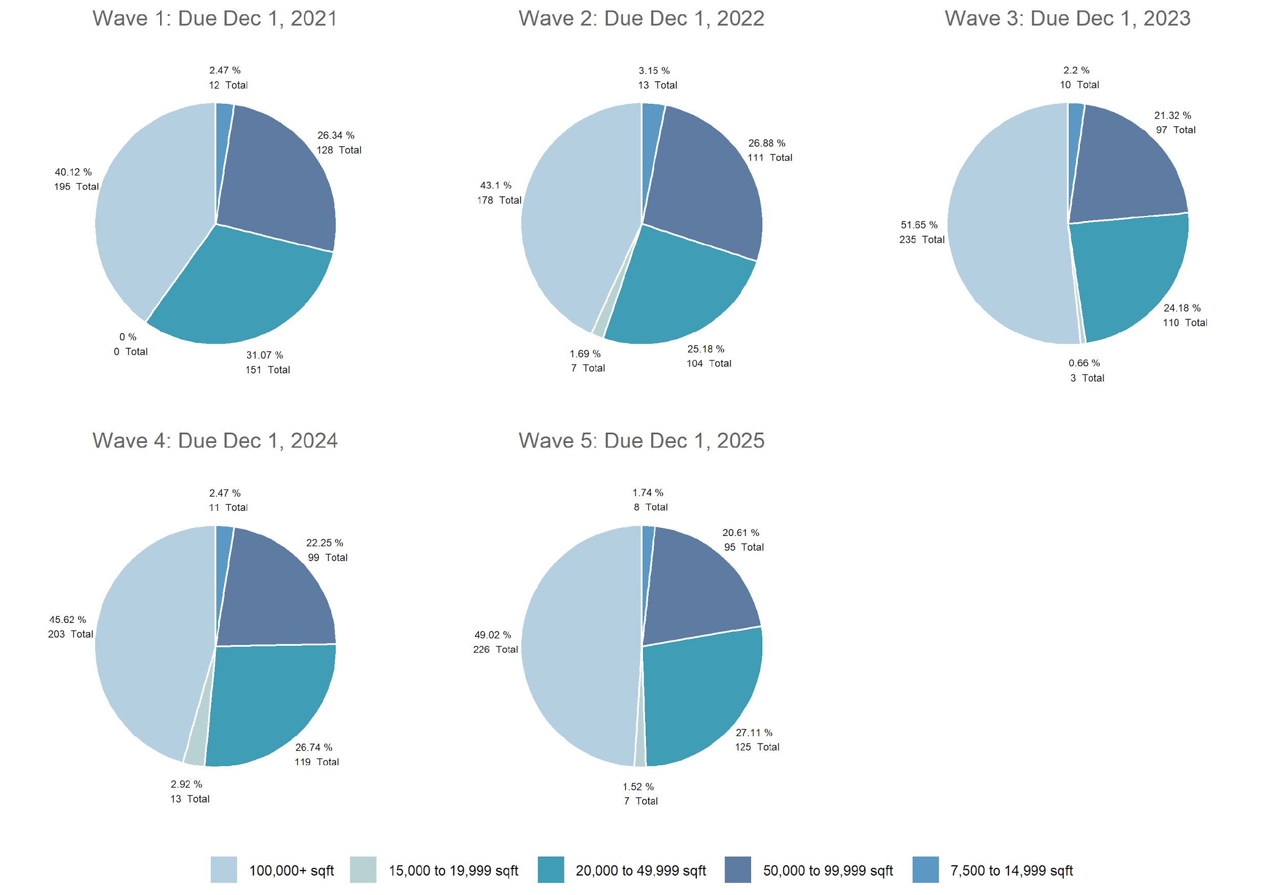
Office Buildings by Wave and SQFT

Slide 53
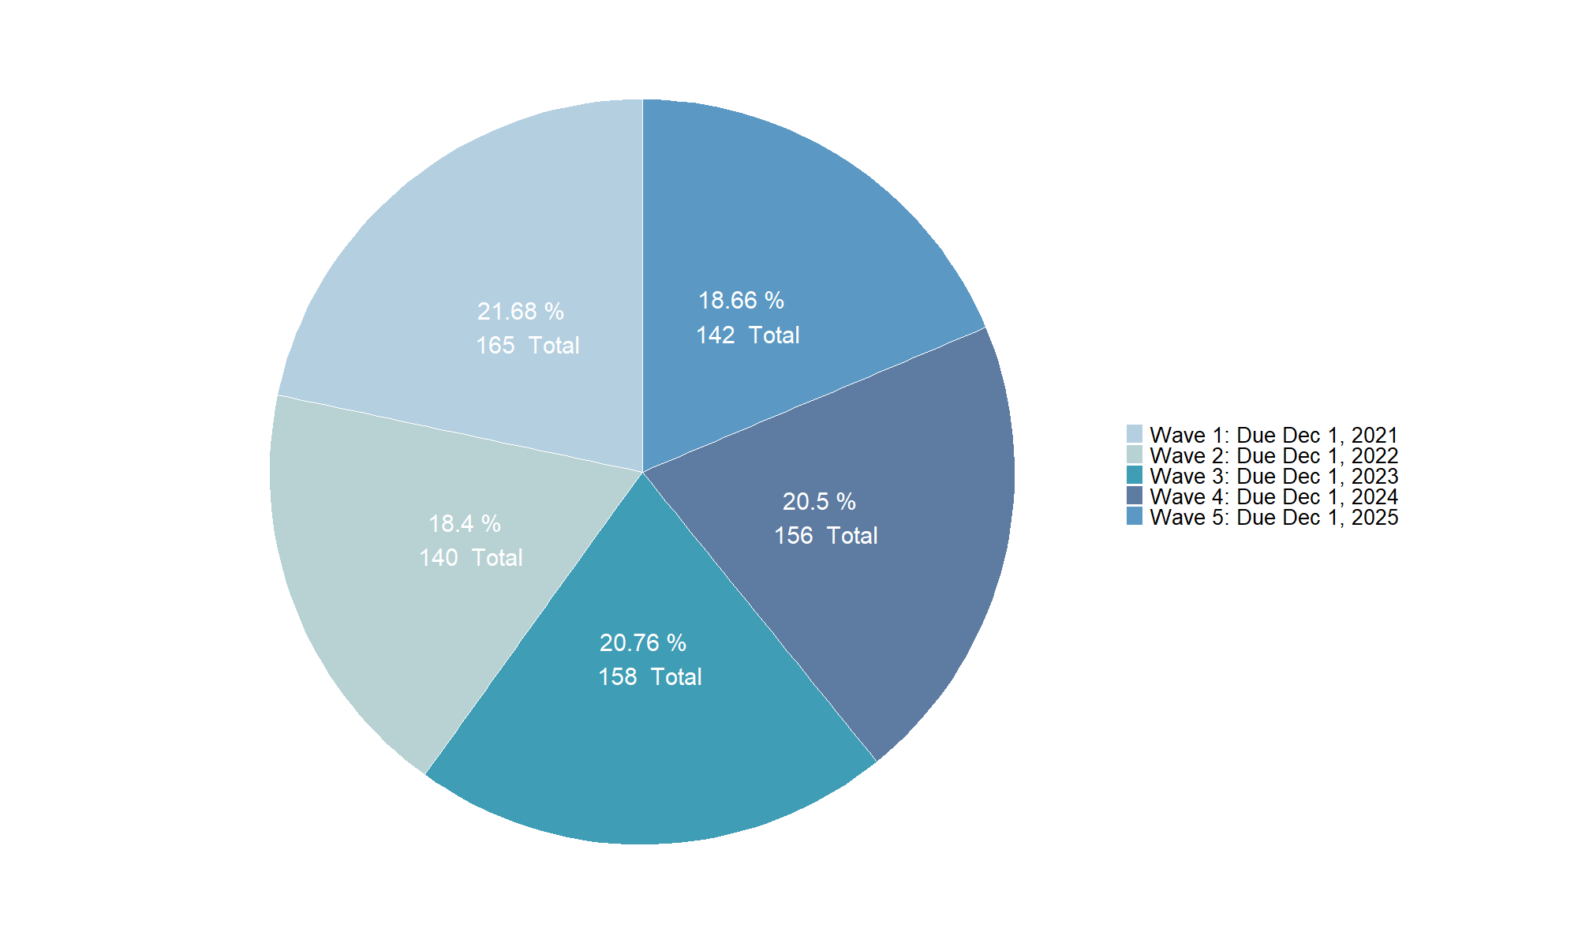
Manufacturing/Industrial Plant by Wave

Slide 54
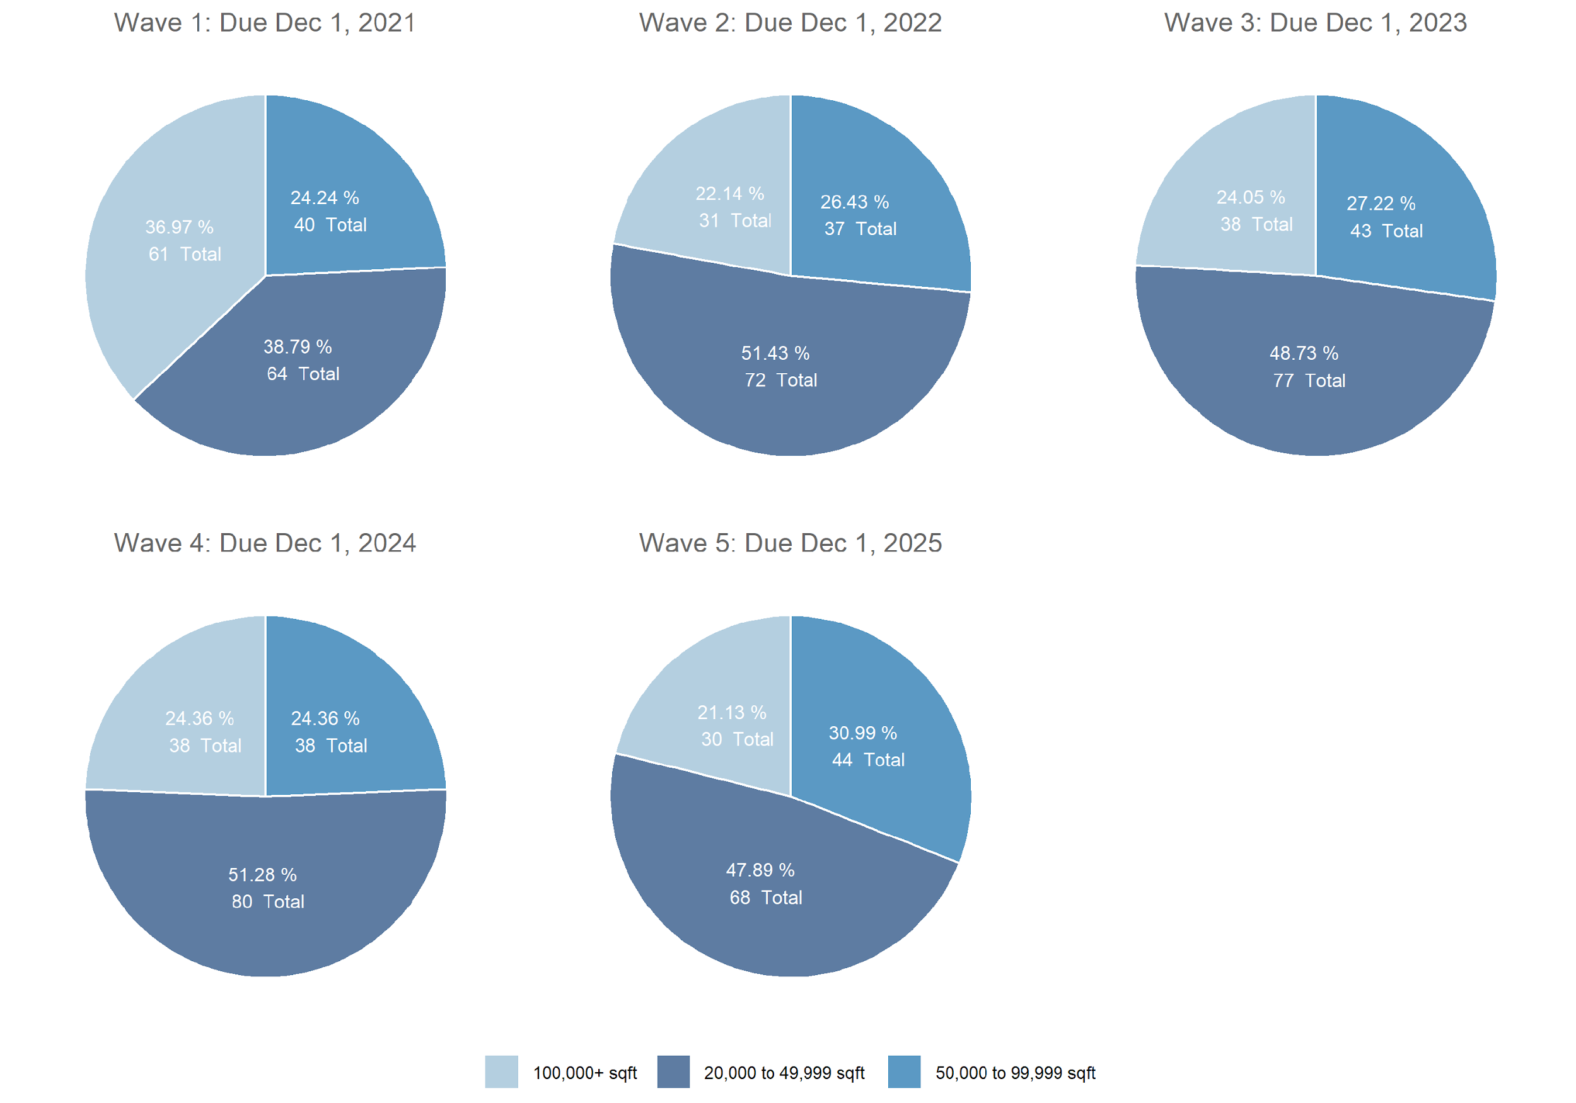
Manufacturing/Industrial Plant by Wave and SQFT

Slide 55
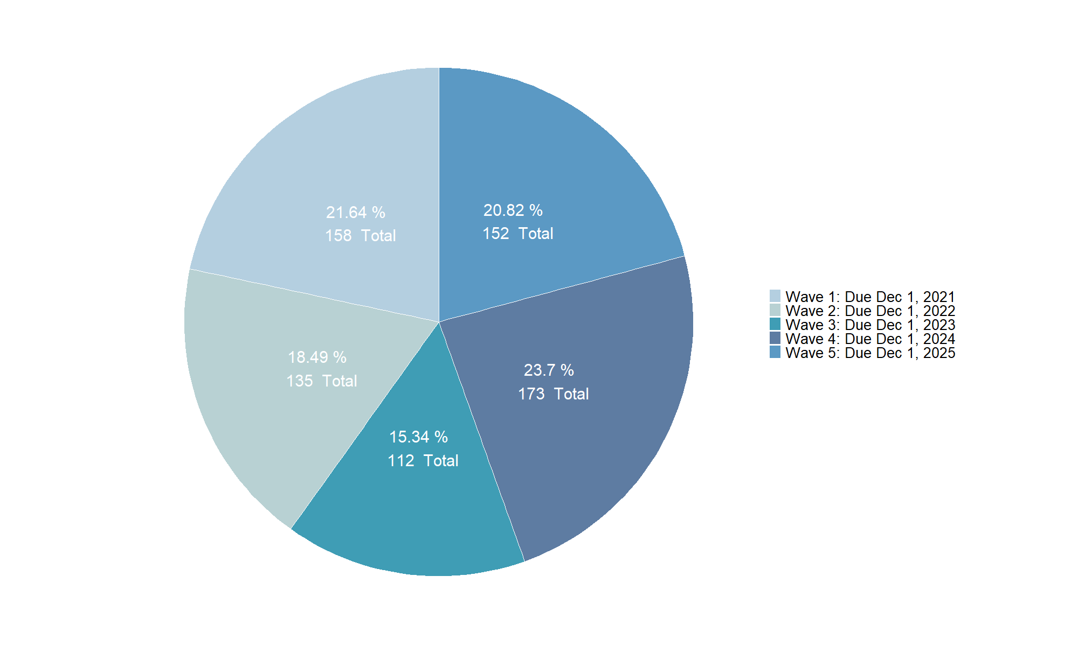
Non-Refrigerated Warehousing by Wave

Slide 56
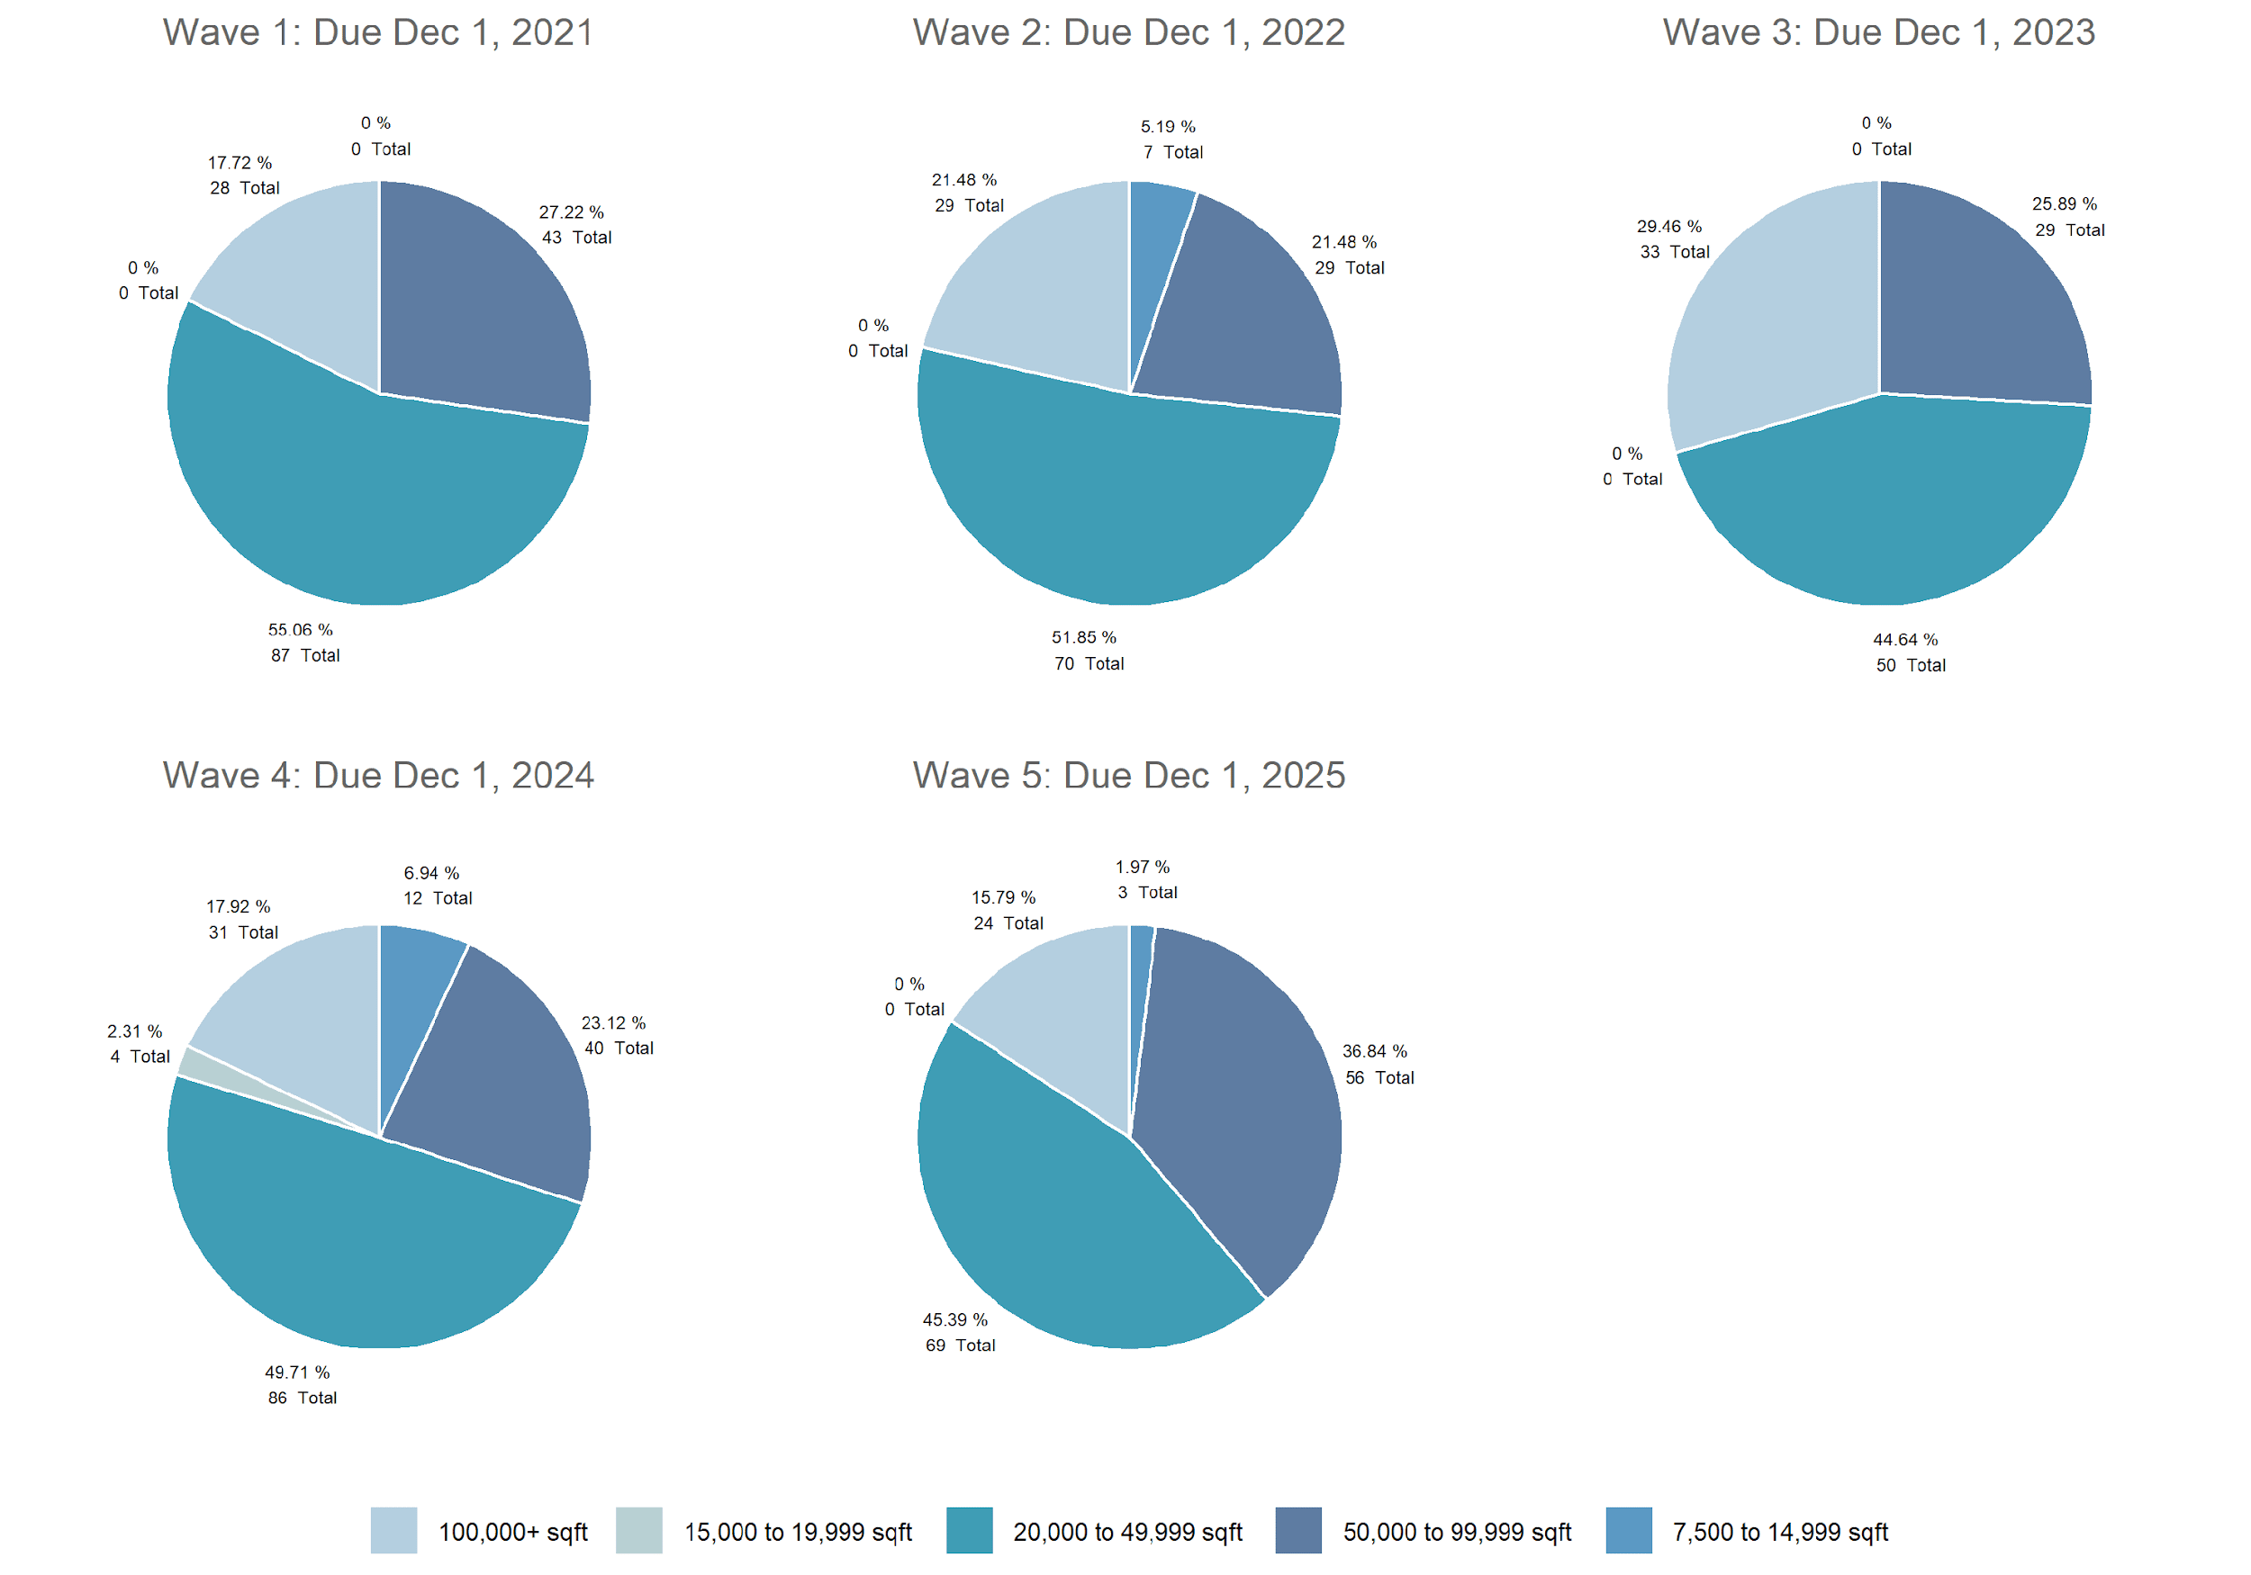
Non-Refrigerated Warehousing by Wave and SQFT

Slide 57
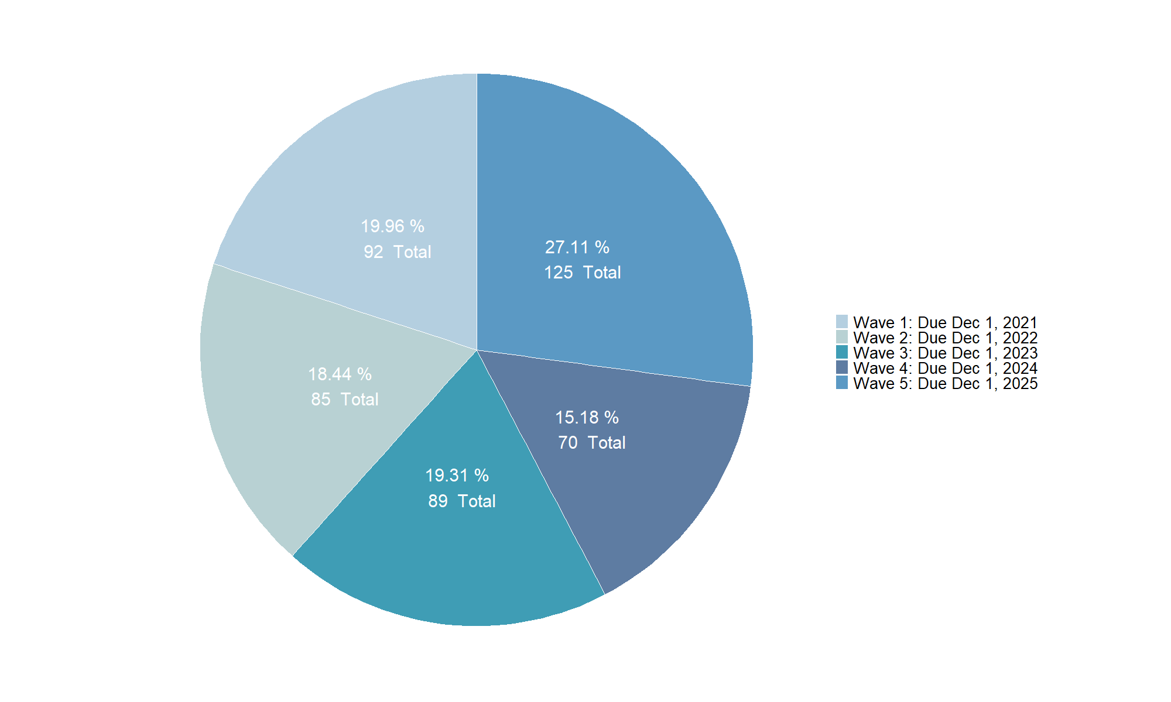
Distribution Centers by Wave

Slide 58
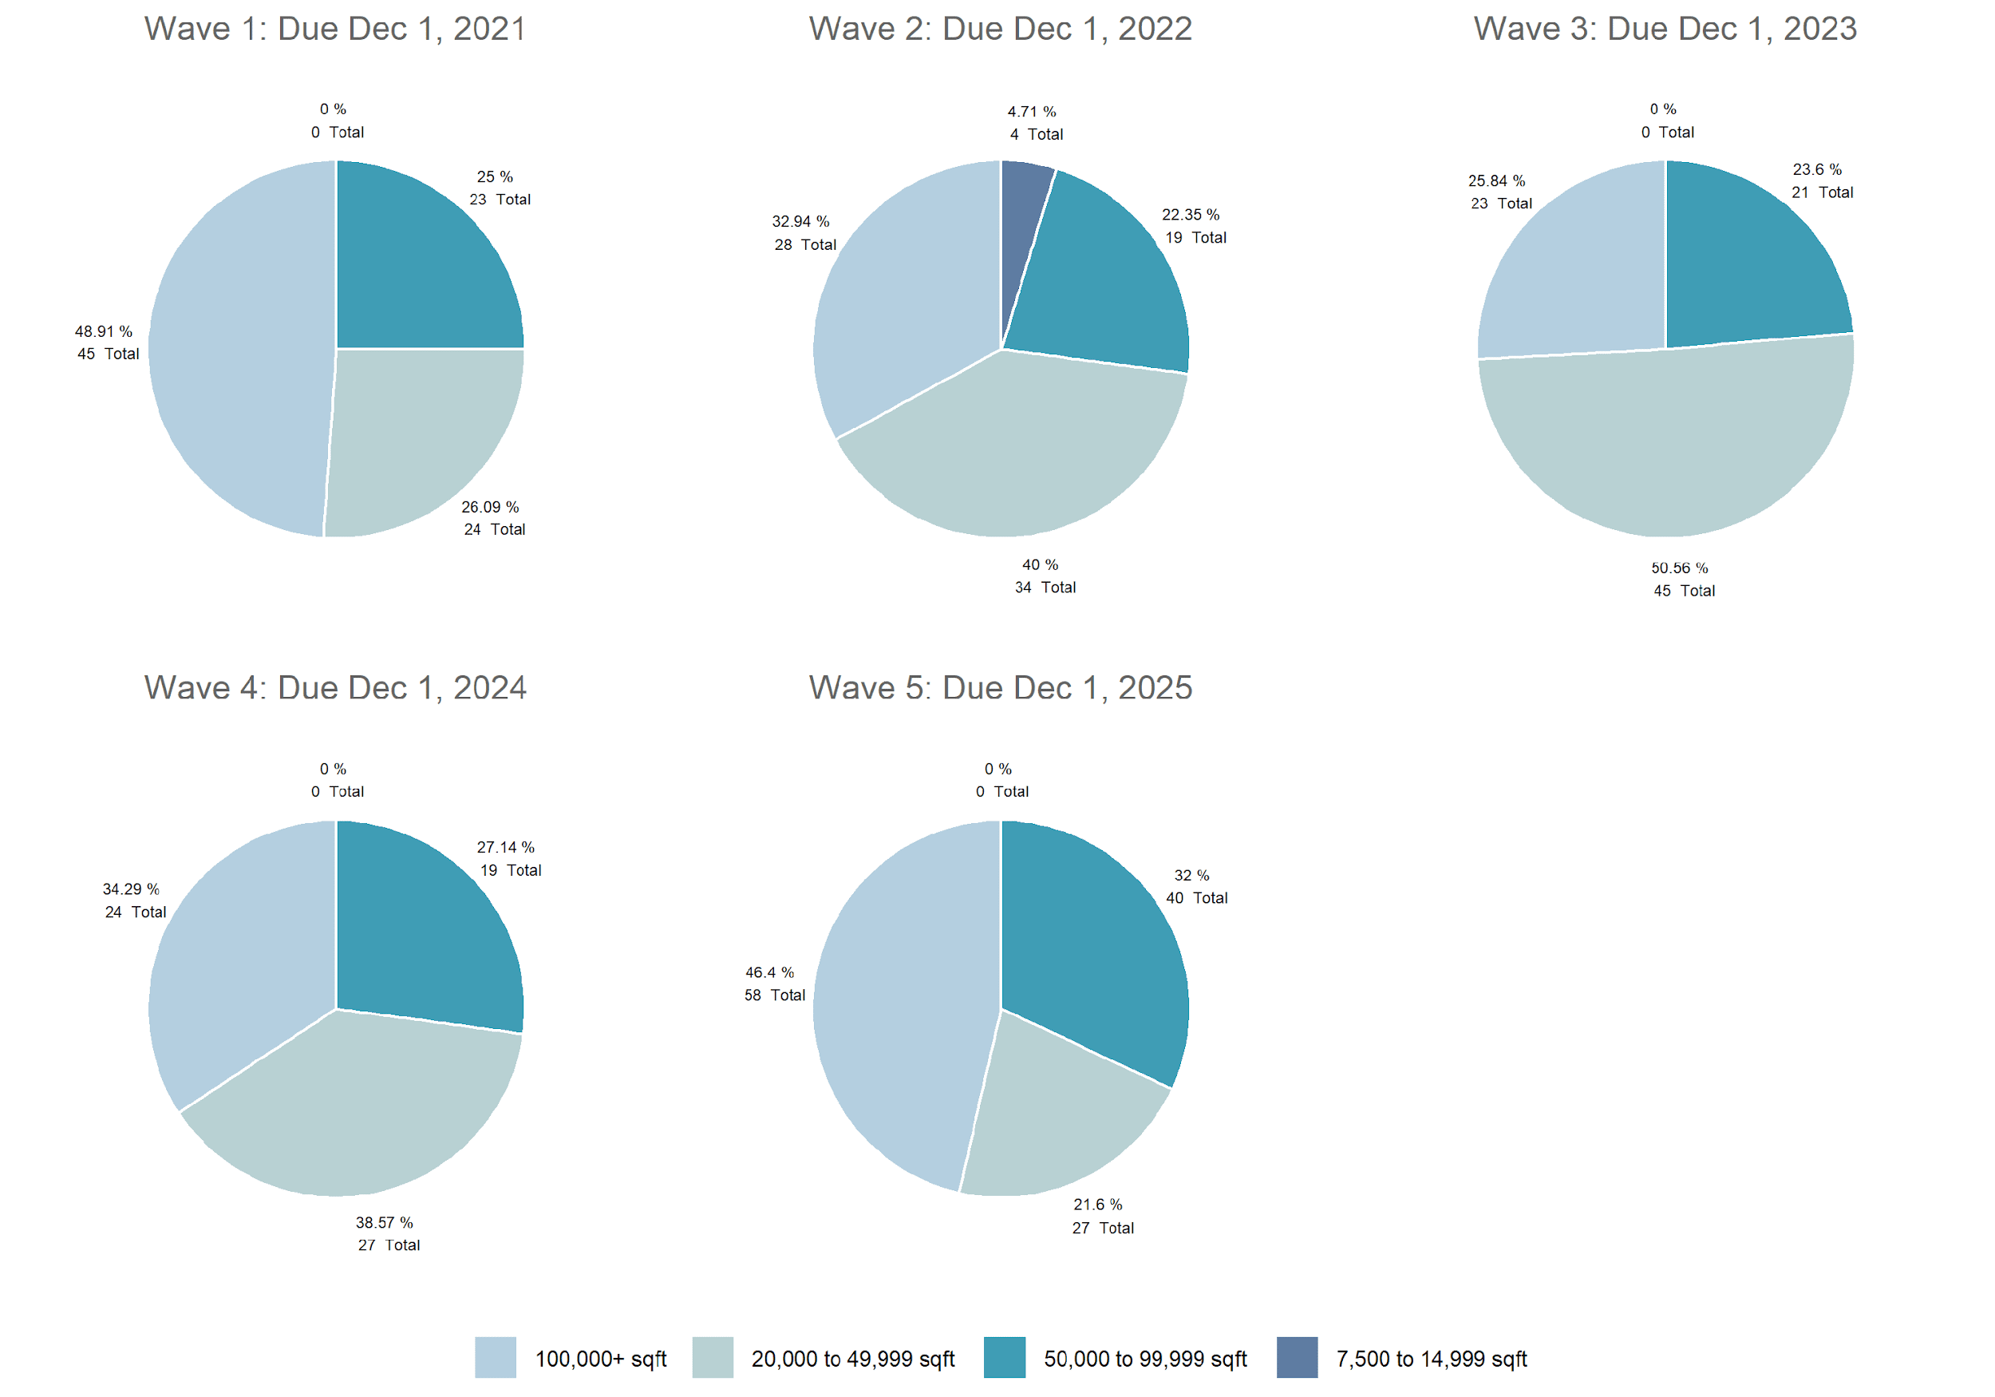
Distribution Centers by Wave and SQFT

Slide 59
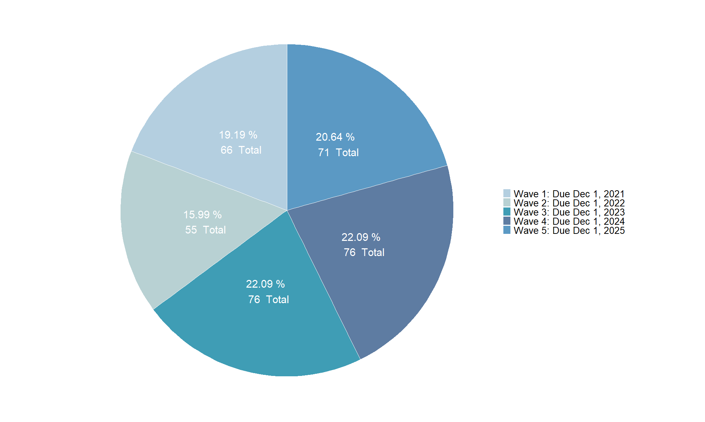
Retail Stores by Wave

Slide 60
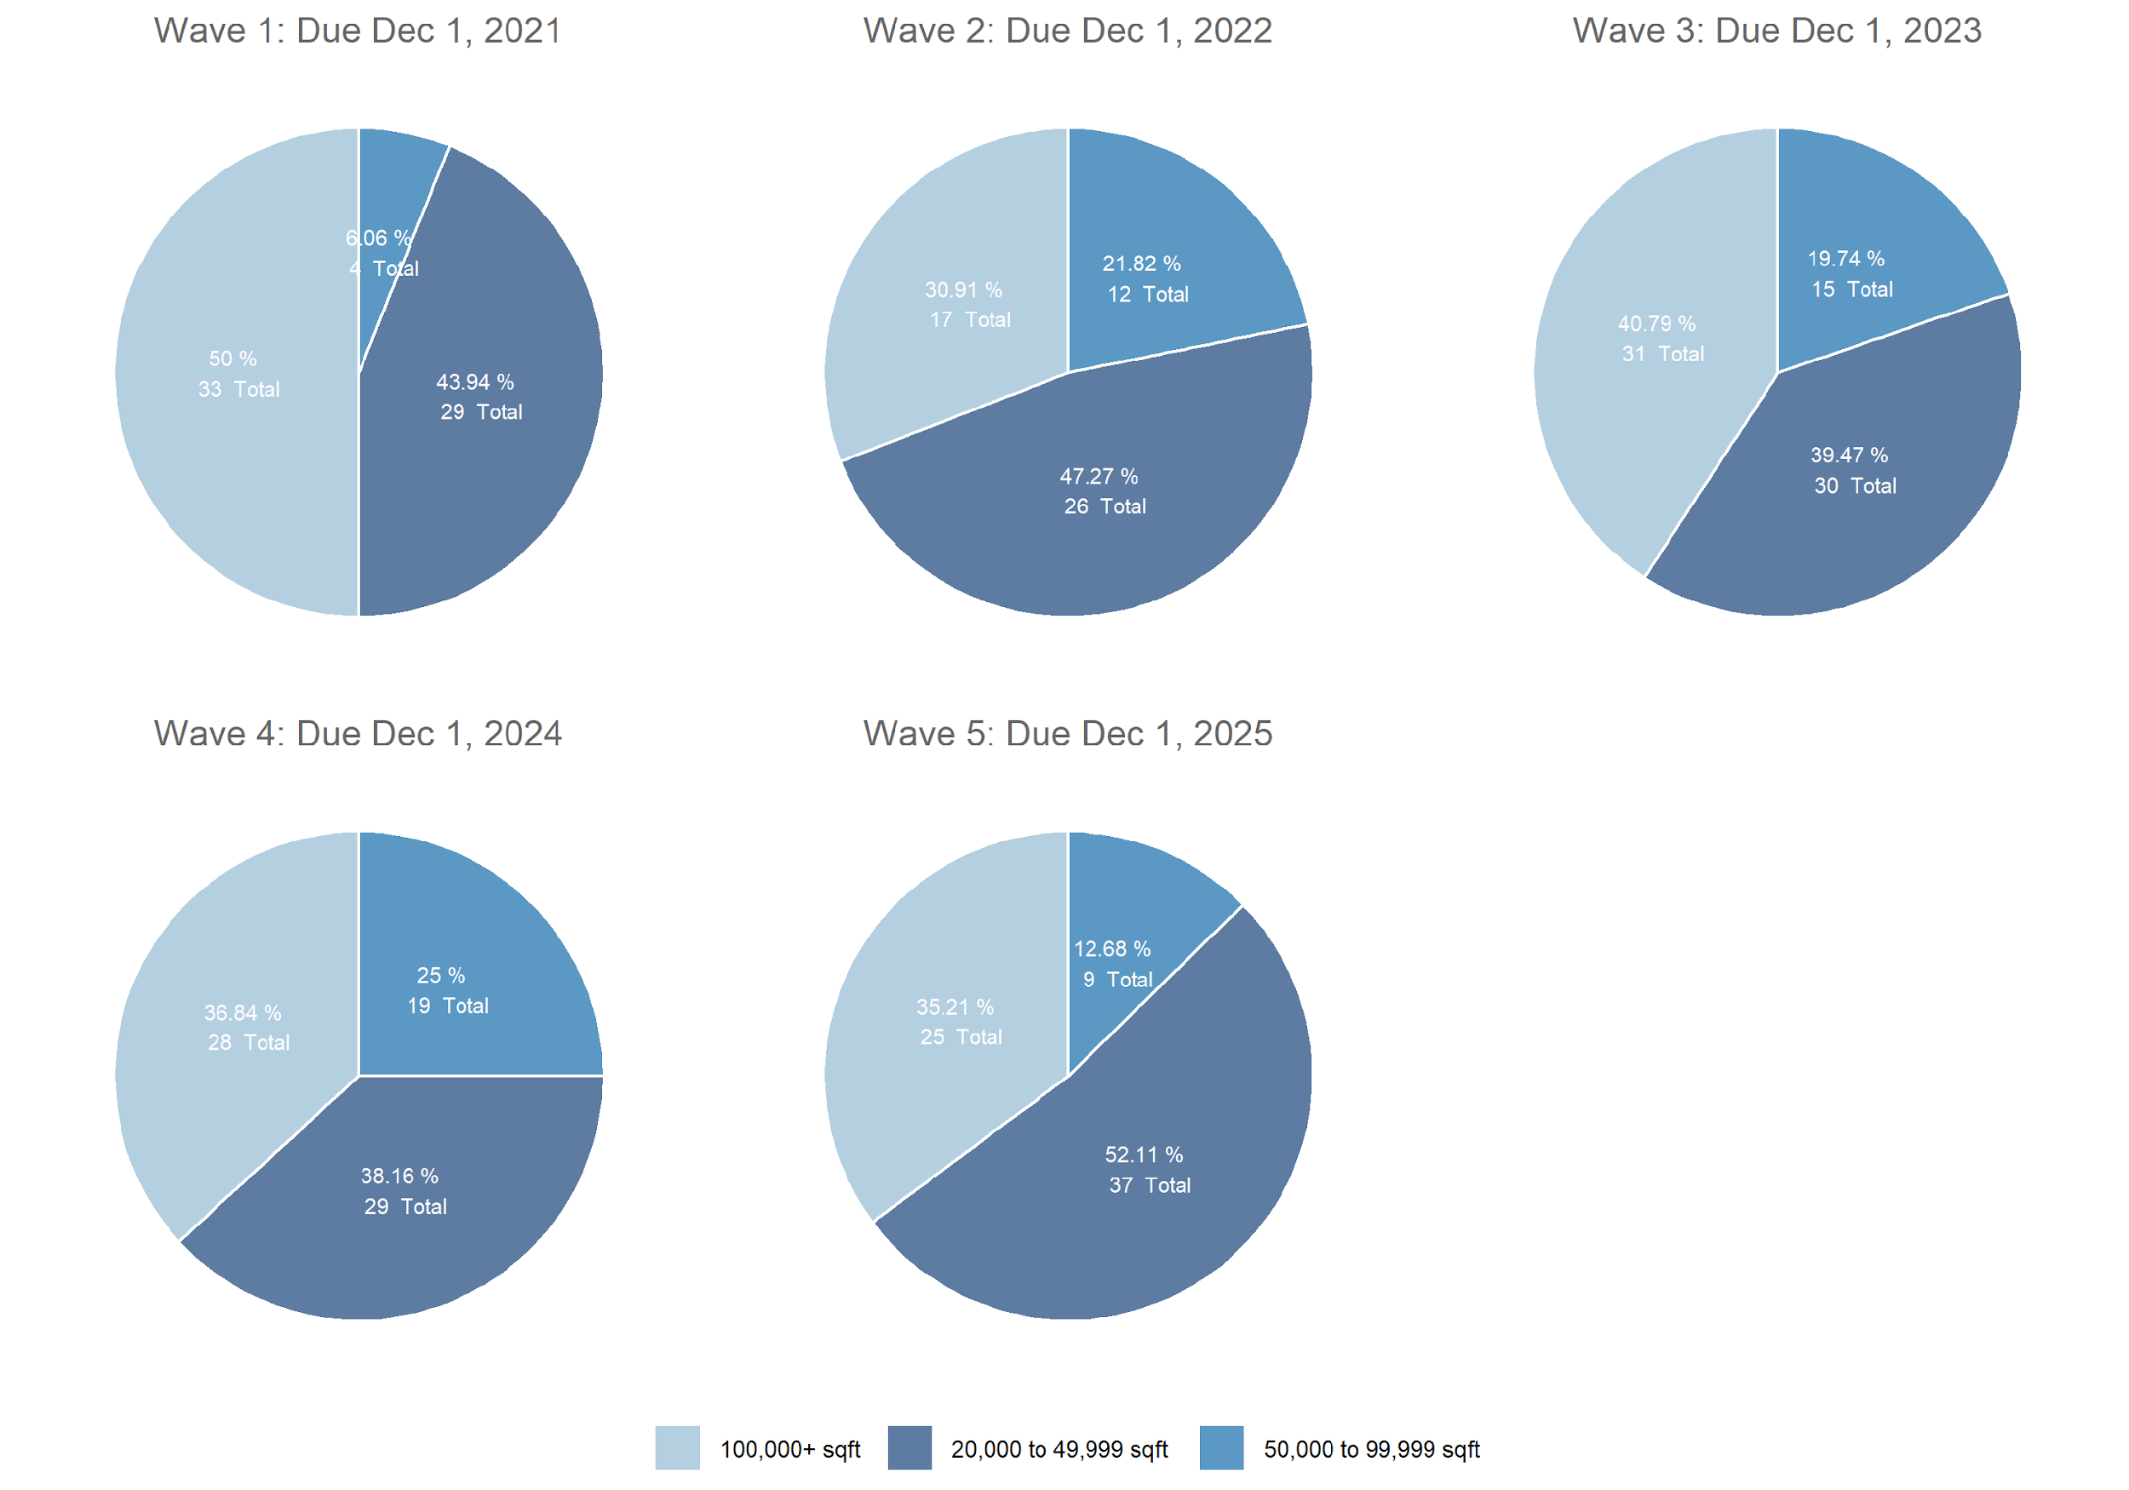
Retail Stores by Wave and SQFT

Slide 61
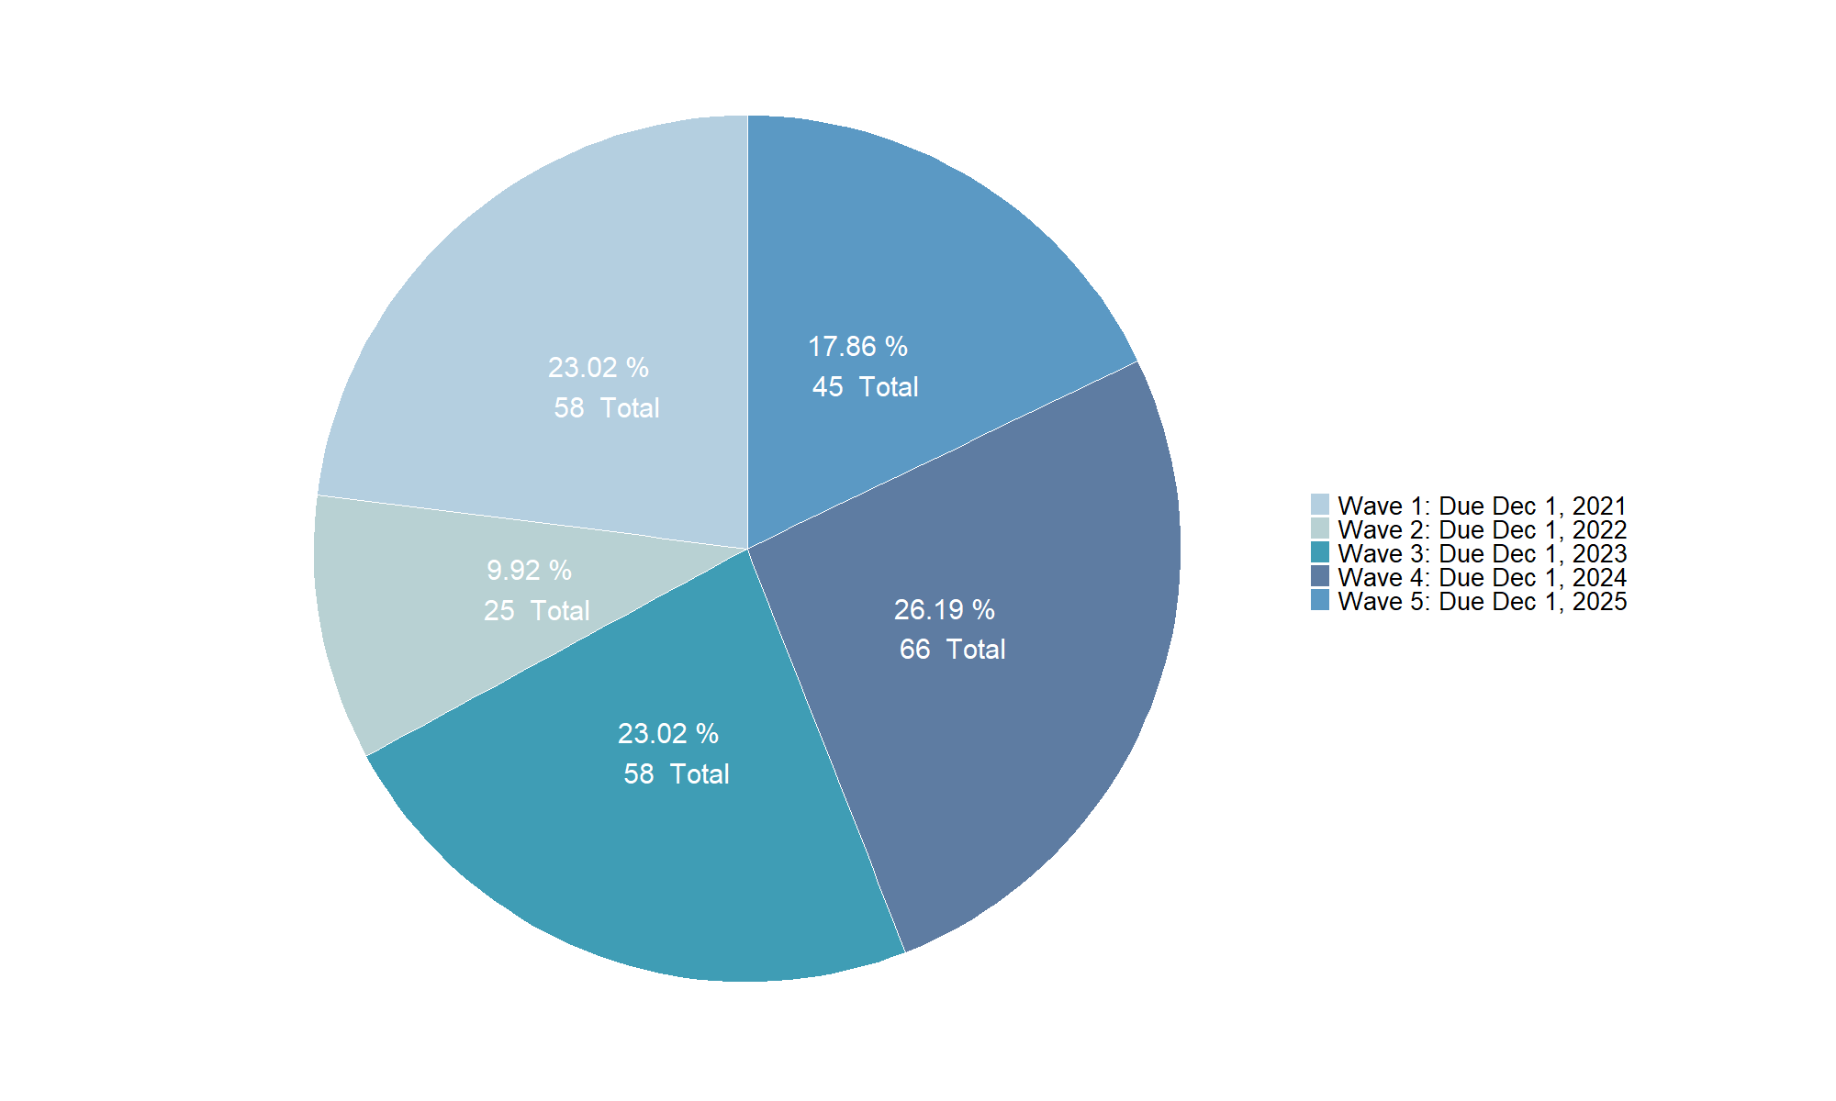
Hotels by Wave

Slide 62
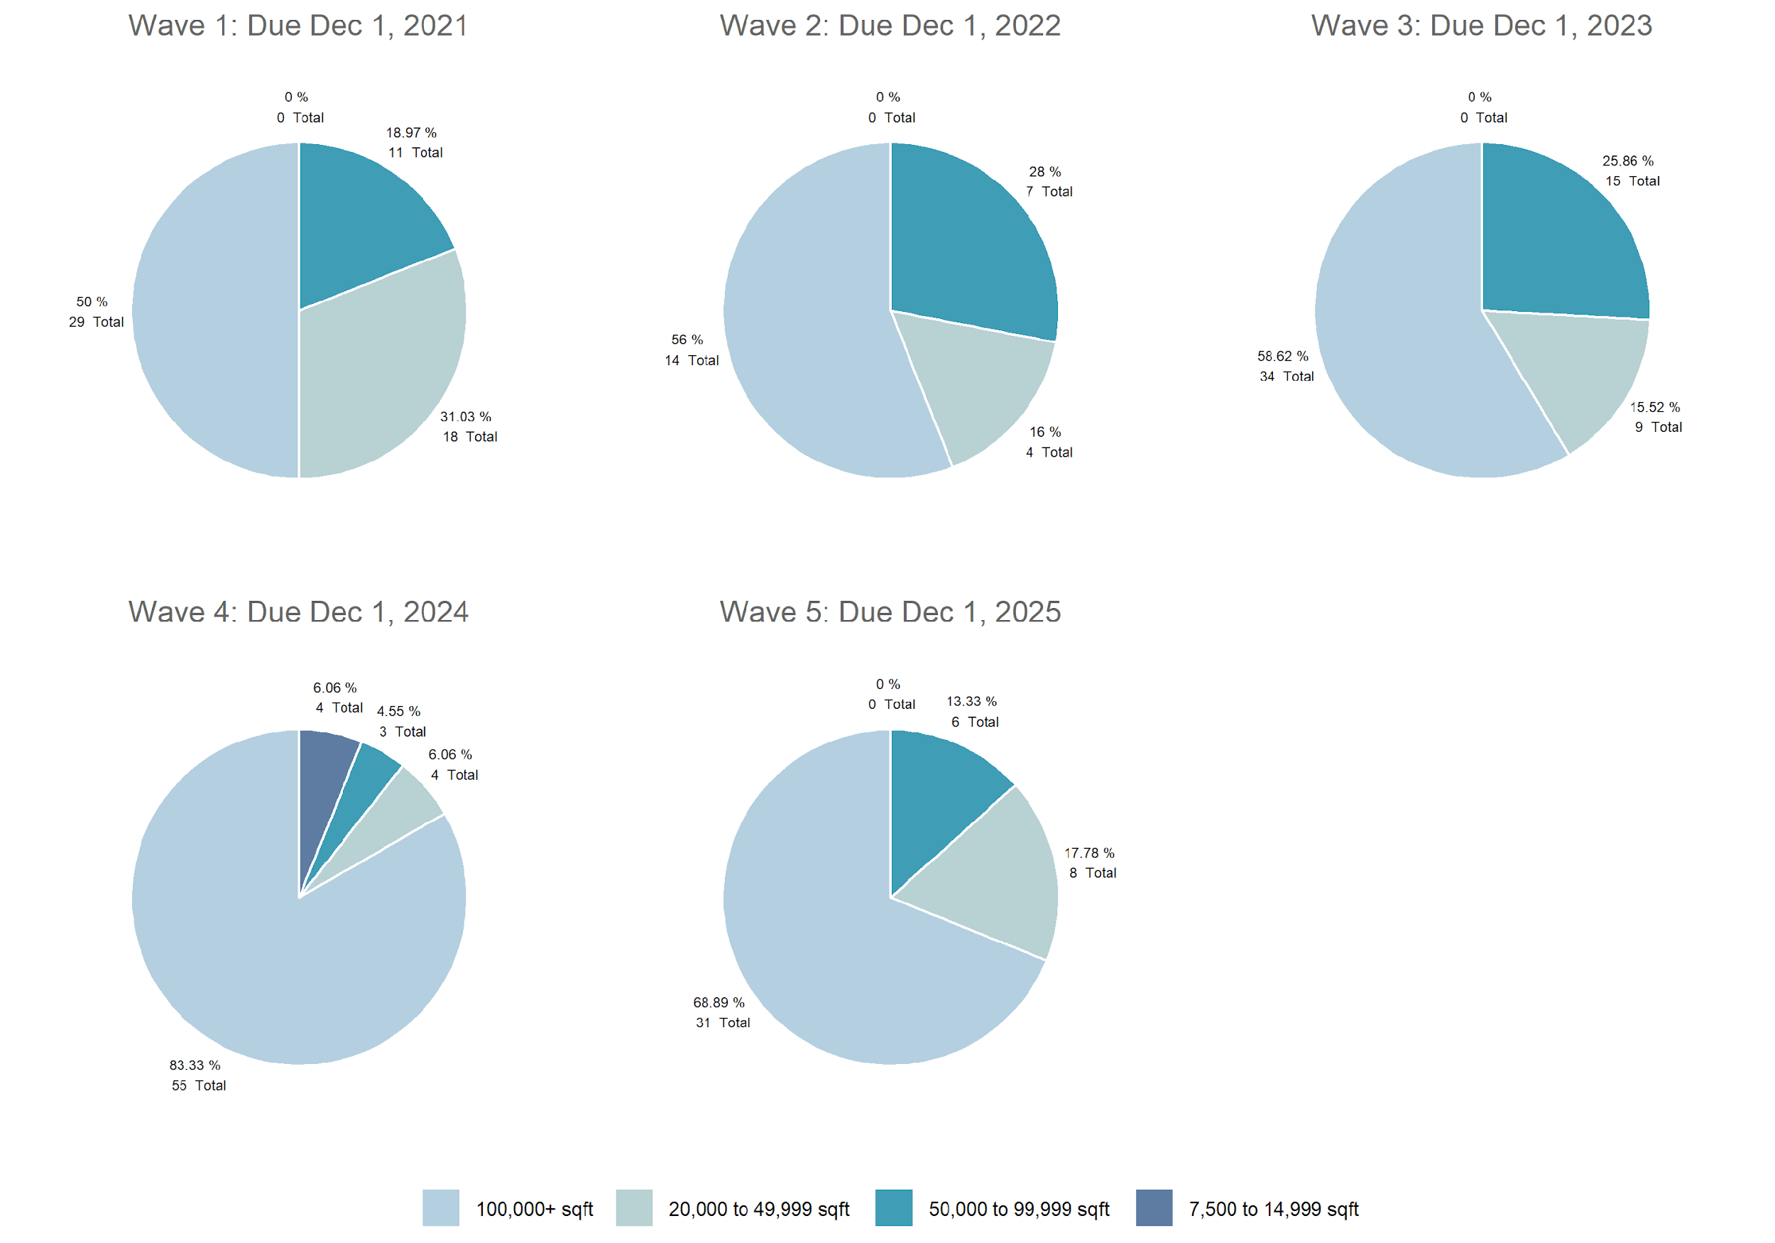
Hotels by Wave and SQFT

Slide 63
DISADVANTAGED COMMUNITIES (DACs)

Slide 64
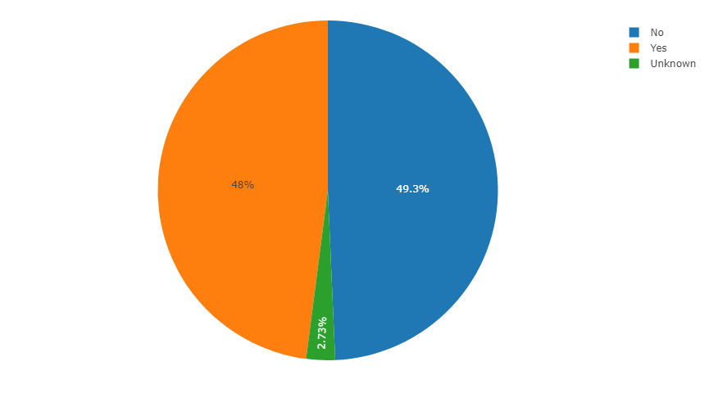
In a DAC? (All Buildings)

Slide 65
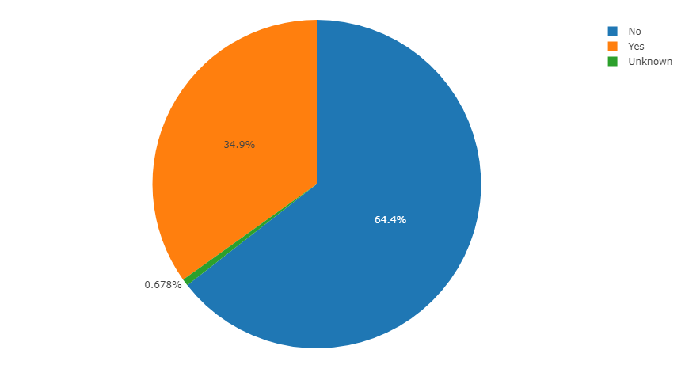
In a DAC? (Multifamily Residential, <100K SF)

Slide 66
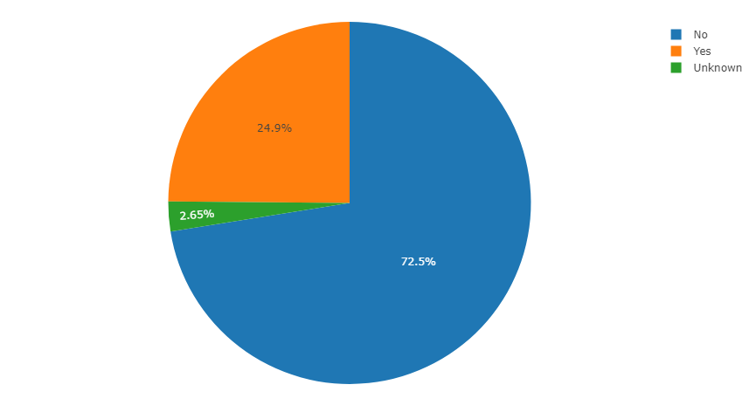
In a DAC? (Office, <100k SF)

Slide 67
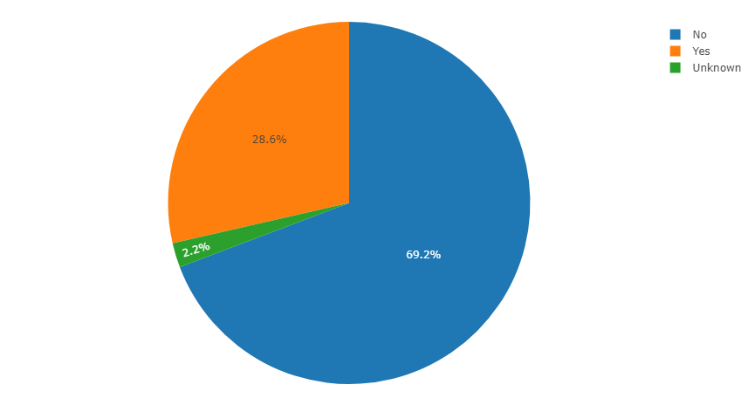
In a DAC? (Retail, <100k SF)

Slide 68
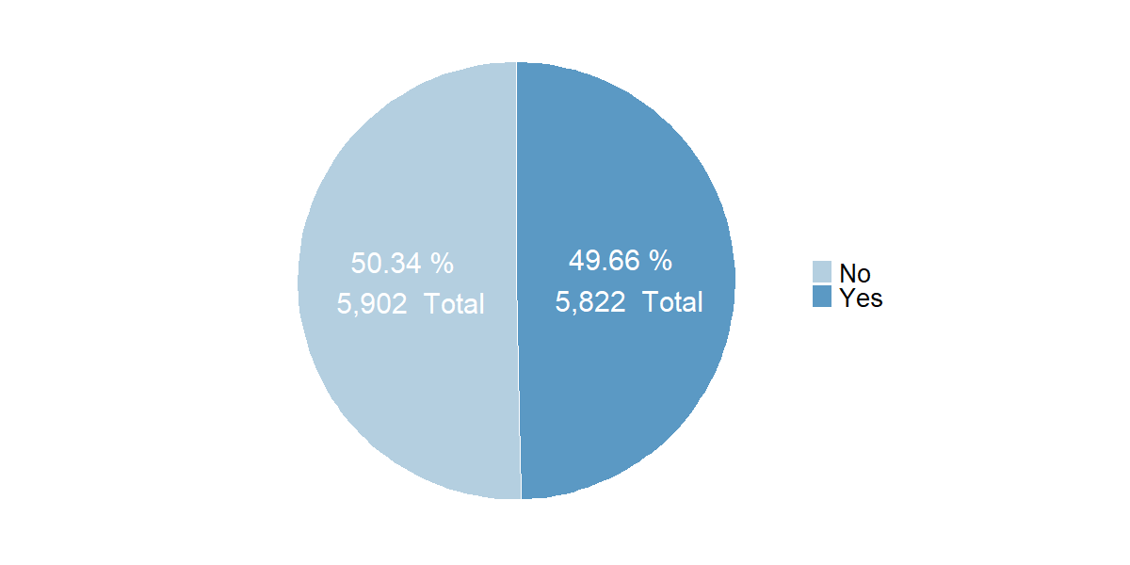
Unique Buildings by Disadvantaged Community (DAC) Indicator
Note: No (Non-Disadvantaged Community), Yes (Disadvantaged Community)

Slide 69
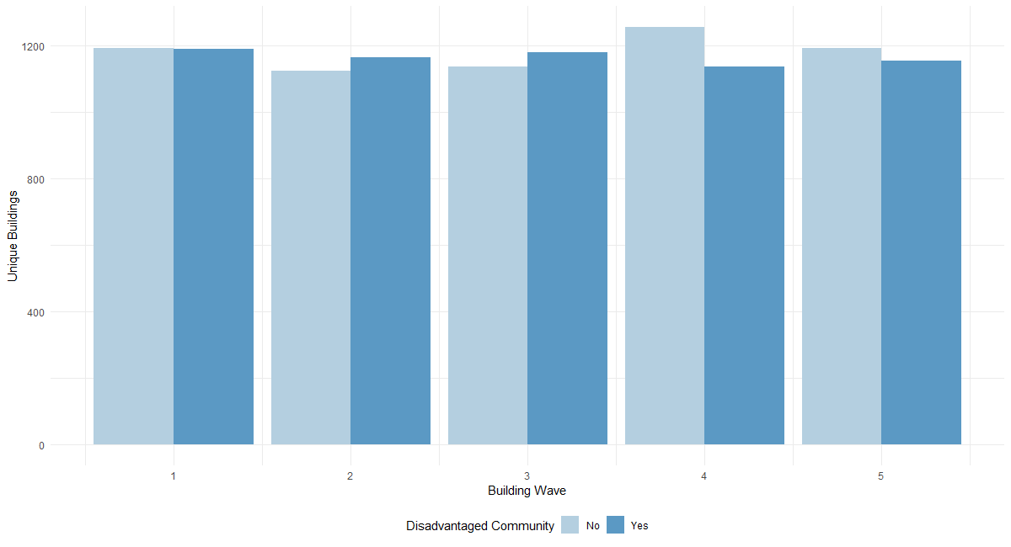
Unique Buildings by DAC Indicator and Building Wave

Slide 70

Top Property Types in Disadvantaged Communities (Top 15 included)

Slide 71

Histogram of CalEnviroScreen Scores

Slide 72
Census Tract Map (Disadvantaged Communities)
Five Census Tracts visibly indicated contain the largest concentrations of unique buildings for the subset of all unique buildings within a DAC.
These Census Tracts are as follows:
6037206031 with 233 unique buildings
6037226002 with 145 unique buildings
6037980028 with 140 unique buildings
6037207301 with 112 unique buildings
6037292000 with 86 unique buildings
The remainder of the census tracts in Disadvantaged Communities contain between 1 to 73 unique building observations each.

Slide 73

Census Tract Map (Non-Disadvantaged Communities)
Five Census Tracts visibly indicated contain the largest concentrations of unique buildings for the subset of all unique buildings not within a DAC.
These Census Tracts are as follows:
6037113303 with 147 unique buildings
6037207710 with 116 unique buildings
6037113421 with 102 unique buildings
6037113237 with 98 unique buildings
6037207900 with 92 unique buildings
The remainder of the census tracts in Non-Disadvantaged Communities contain between 1 to 78 unique building observations each.

Slide 74
CityBES SIMULATION RESULTS

Slide 76





Slide 77





Slide 78





Slide 79






Histogram of Annual Source Energy Use intensity (Advanced 1)

Slide 80




Histogram of Annual Source Energy Use intensity (Advanced 2)

Slide 81






Histogram of Annual Source Energy Use intensity (Basic)

Slide 82

Histogram of Annual Source Energy Use intensity (Mid)

Slide 85


Slide 86

Histogram of Investment Costs (Advanced 1)

Slide 87

Histogram of Investment Costs (Advanced 2)

Slide 88

Histogram of Investment Costs (Basic)

Slide 89

Histogram of Investment Costs (Mid)

Slide 90


Slide 91

Histogram of Energy Savings (Advanced 1)

Slide 92

Histogram of Energy Savings (Advanced 2)

Slide 93

Histogram of Energy Savings (Basic)

Slide 94

Histogram of Energy Savings (Mid)

Slide 95


Slide 96

Histogram of Average Cooling Capacity

Slide 97

Histogram of Number of HVAC Units

Slide 98
AC OP and CDI HVAC Details, Investment Costs

Slide 99
HVAC Types for AC OP Buildings
In General
94% - Type 4 (2008 total)
.0004% - Type 3 (1 total)
.0286% - Type 2 (61 total)
.02725 - Type 1(58 total)
MultiFamily
100%, Type 4
1983 total
Retail
34% - Type 4 (25 total)
.0135% - Type 3 (1 total)
39% - Type 2 (29 total)
23% - Type 1 (19 total)
Office
54% - Type 1 (39 total)
46% - Type 2 (32 total)
Notes:
Tony

Slide 100
HVAC Units for AC OP Buildings
In General
1- 5 Units
Wide Range by MultiFamily
MultiFamily
Median - 4
IQR - 17
Mean - 26
Retail
75% - 1 Unit (56 total)
25% - 2 Units (18 total)
Office
22% - 1 Unit (16 total)
12% - 2 Units (9 total)
66% - 3 Units (46 total)
Notes:
Tony

Slide 101
TOTAL INVESTMENT COST ($) PREDICTION
Basic Package
Retail:
$1.4 Million (Total Inv. Cost)
$12.4 Thousand (Median Inv. Cost)
Multi-Family Housing:
$34.6 Million (Total Inv. Cost)
$12.7 Thousand (Median Inv. Cost)
Office:
$27.9 Million (Total Inv. Cost)
$26.1 Thousand (Median Inv. Cost)
Grand Total: 63.9 Million
Mid Package
Retail:
$5.2 Million (Total Inv. Cost)
$47.6 Thousand (Median Inv. Cost)
Multi-Family Housing:
$132.5 Million (Total Inv. Cost)
$48.6 Thousand (Median Inv. Cost)
Office:
$106.8 Million (Total Inv. Cost)
$100.1 Thousand (Median Inv. Cost)
Grand Total: 85.2 Million
Advanced 2 Package
Retail:
$5.7 Million (Total Inv. Cost)
$52.2 Thousand (Median Inv. Cost)
Multi-Family Housing:
$145.3 Million (Total Inv. Cost)
$53.2 Thousand (Median Inv. Cost)
Office:
$117 Million (Total Inv. Cost)
$109.8 Thousand (Median Inv. Cost)
Grand Total: 268 Million
Note: All investment costs were calculated for a subset of building data which all modeled variables were complete (i.e., 2622 total buildings, 2013 multi-family housing, 526 retail, and 83 office buildings). All costs were based on a small set of simulated observations which may or may not introduce bias in the extrapolation process which would alter the total and median investment costs depicted above.

Slide 102

k-Nearest-Neighbors Algorithm

